Slide 1
Li-enriched oilfield brines
Kyle Henderson, PhD Candidate
McGill University
Hydrothermal Geochemistry Group
Kyle.Henderson@mail.mcgill.ca

Slide 2
PhD Research
Shale geochemistry
Diagenetic mobility/partitioning of trace-elements

Slide 3
PhD Research
Hyper-enriched black shales (Yukon, Canada + Zunyi, South China)
~4 wt% Ni content
Millerite – NiS
Ba-NH₄-feldspar

Slide 4
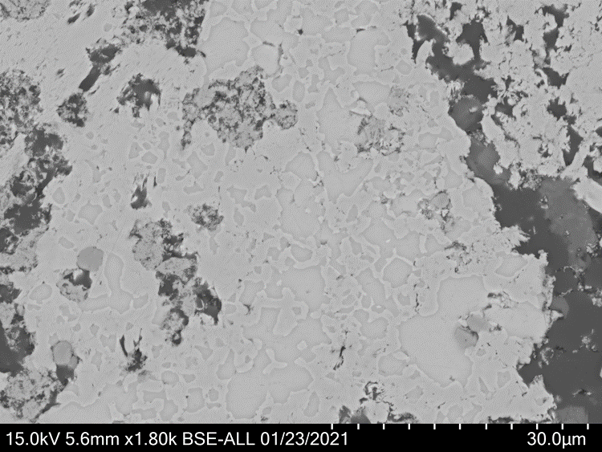
PhD Research
Hyper-enriched black shales (Yukon, Canada + Zunyi, South China)
NiS
ZnS
NiS replacing ZnS via late-diagenetic dissolution

Slide 5
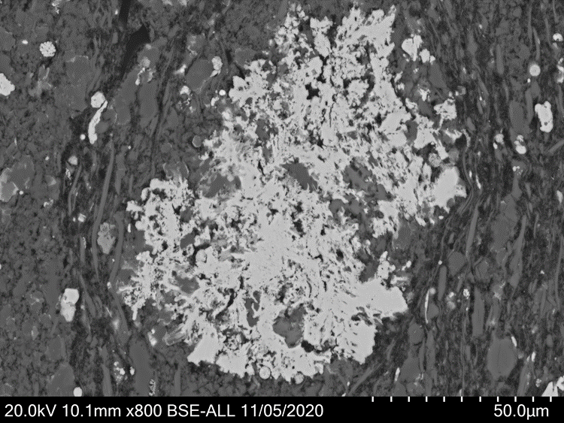
PhD Research
Ba-NH₄ feldspars
V-enriched via liquid hydrocarbons(?)
Related to V (and Zn) mobilization during hyper-enriched shale burial
Organic matter
Mann
Mannardite – BaTiV₂O₁₆(H₂O), 13 wt% V

Slide 6
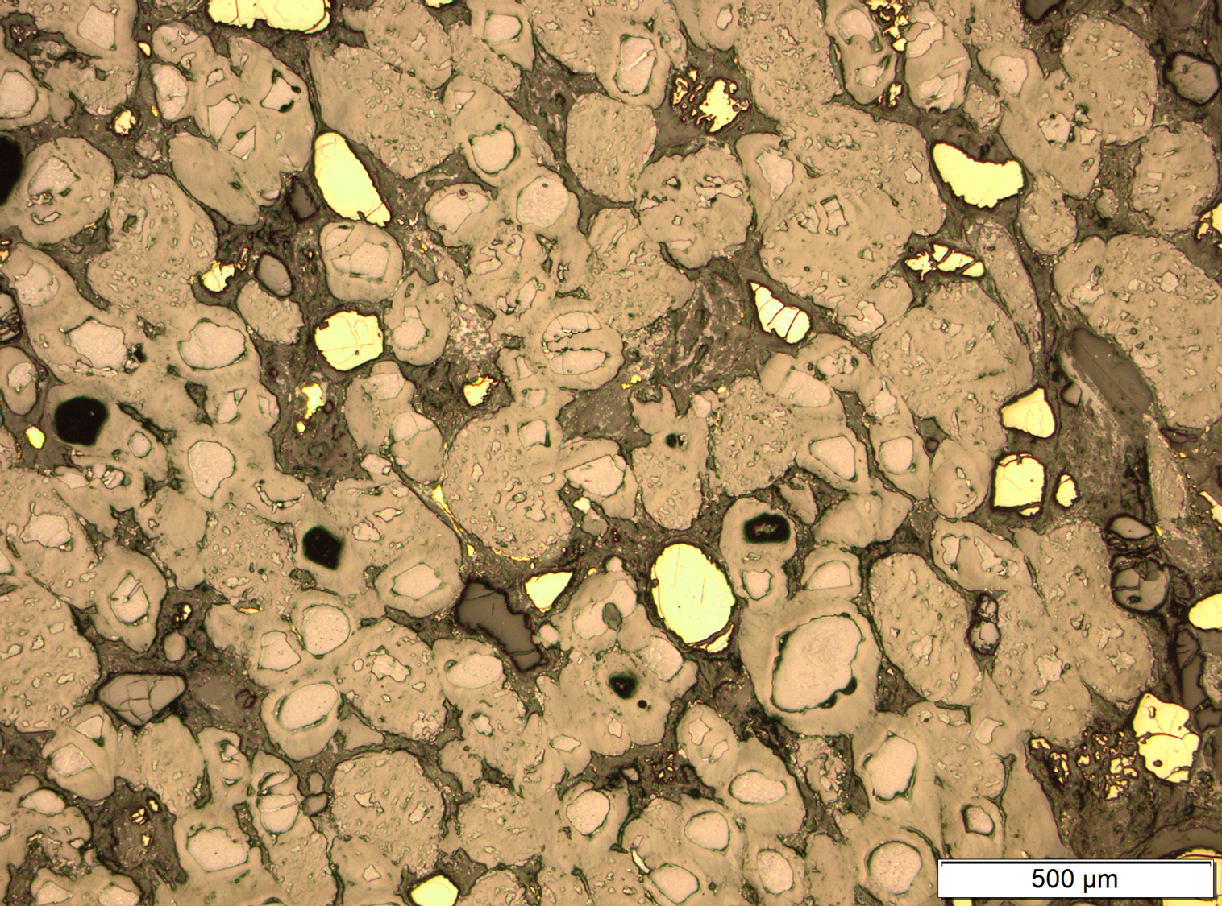
PhD Research
Detrital uraninite and pyrite embedded in pyrobitumen within conglomerate horizon in the Witwatersrand Gold deposits, South Africa
Role of liquid hydrocarbons in transporting uraninite

Slide 7
Gold
PhD Research
V-enriched via liquid hydrocarbons(?)
Related to V (and Zn) mobilization during hyper-enriched shale burial
Uraninite – UO₂
Pyrite
Pyrobitumen
2.9 billion years old.

Slide 8
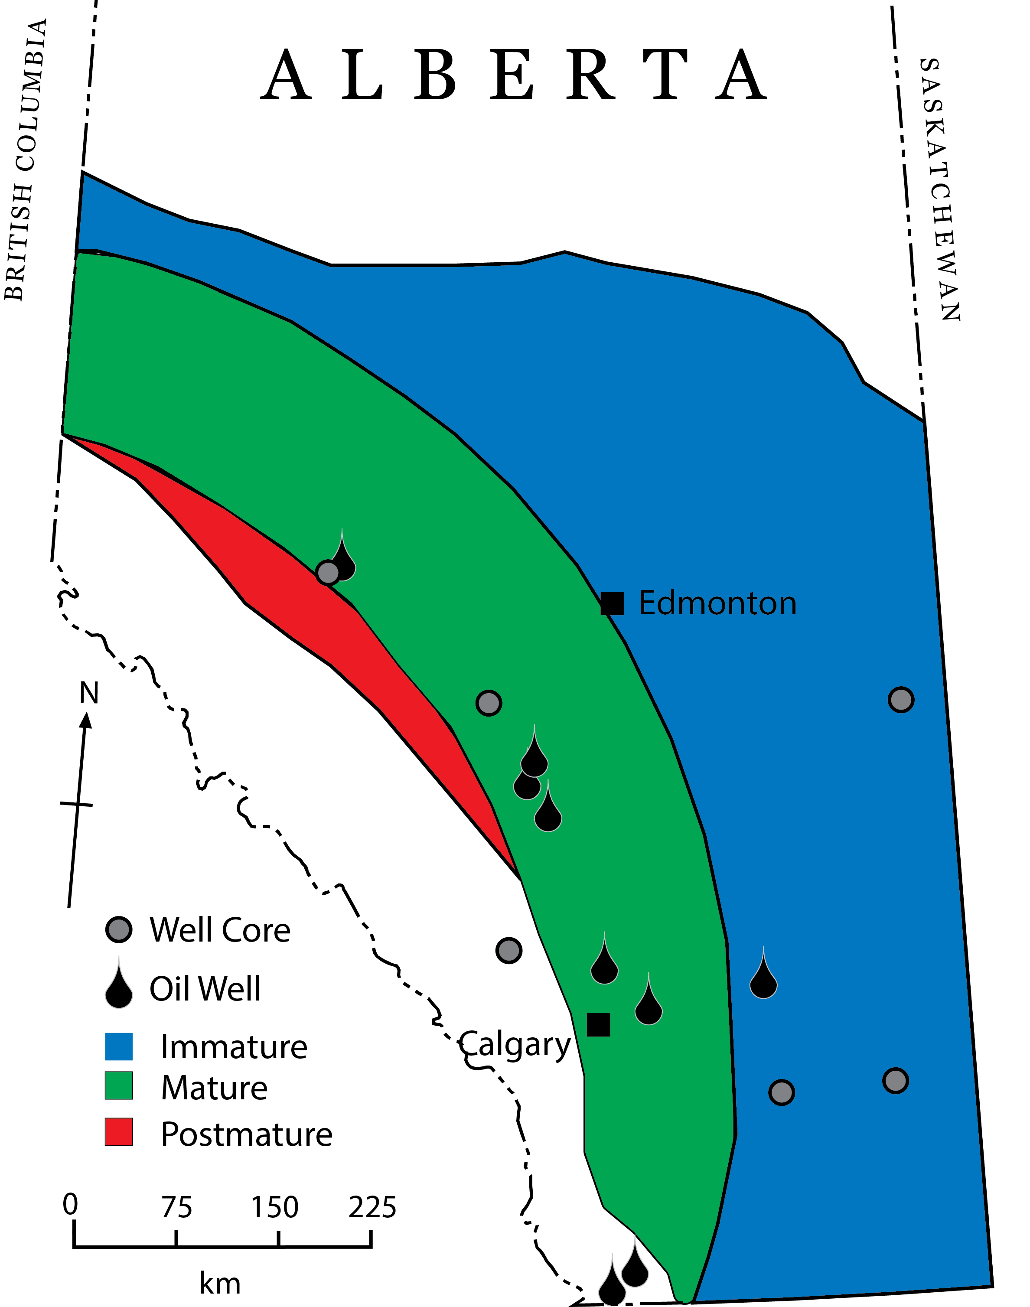
PhD Research
Tracking major/minor/trace element change through diagenesis/hydrocarbon generation
Trace-element content of oil in Western Canadian Sedimentary basin

Slide 9
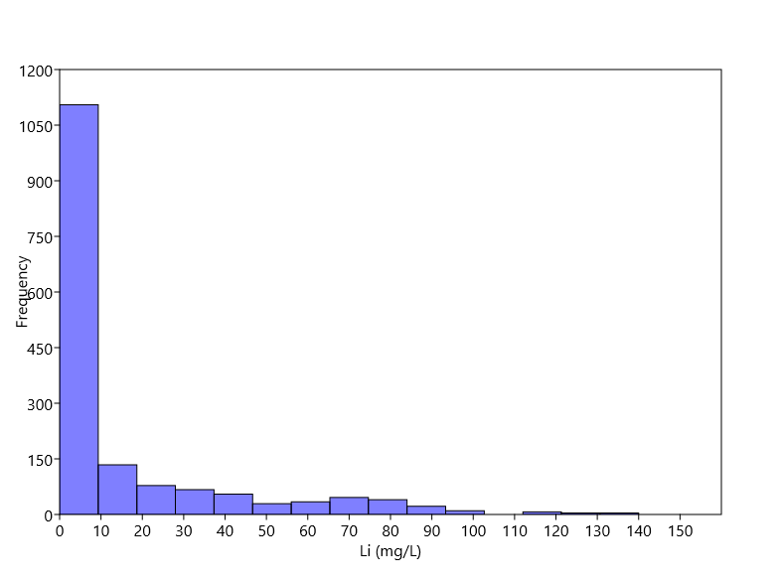
Li content in Oilfield brines in Alberta
This talk’s topic
30% >
10 mg/L
10% >
50 mg/L
Li-concentration in oilfield brines
N = 1635, 47 different formations

Slide 10
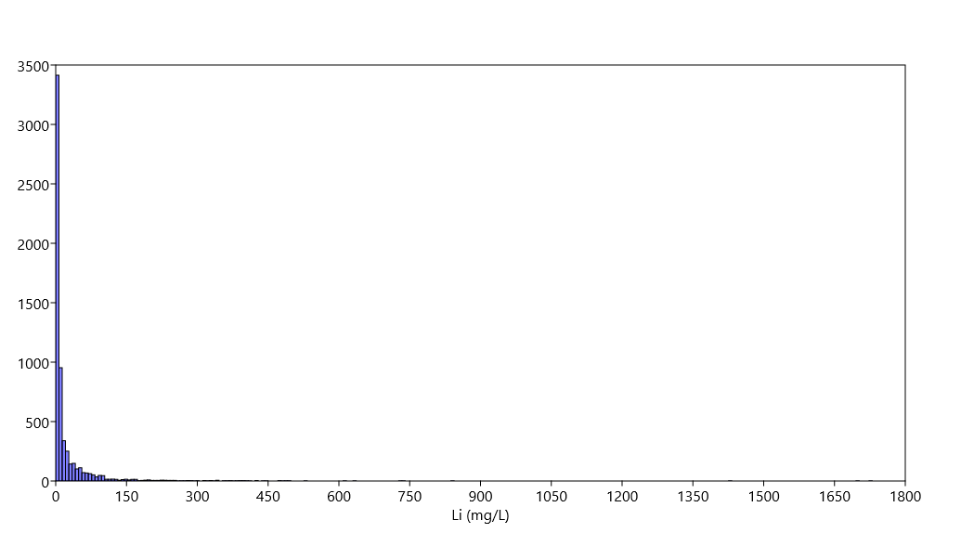
USGS Water database (n = 6110)

Slide 11
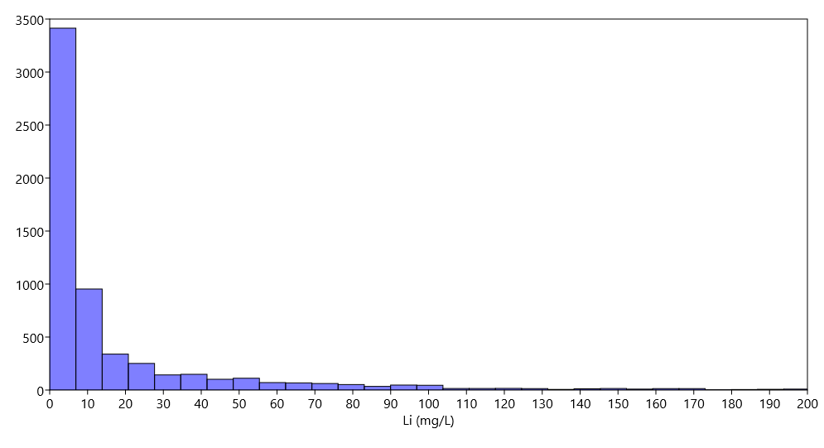
USGS Water database
30% >
10 mg/L
4% >
100 mg/L

Slide 12
Li-enriched waters
Several basins are known to host Li-enriched formation waters
Smackover Formation (10’s to 100’s mg/L), Bakken Formation (40-80 mg/L)
However, other basins have Li-poor waters
Silurian to Pennsylvanian reservoirs in the Illinois basin (<10 mg/L)
What controls Li-enriched in formation waters? Why do some basins have Li-enriched but others do not?

Slide 13
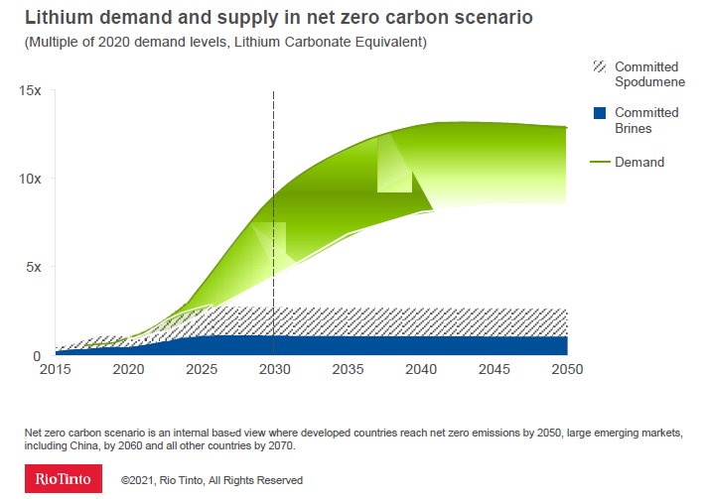
Cars like lithium
Supply deficit of Li with growing EV sector (50% of Li supply by 2030)

Slide 14
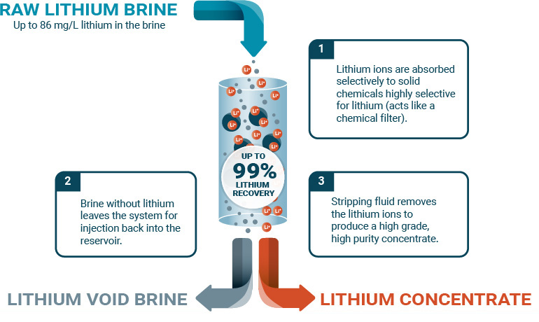
E3-Metals

Slide 15
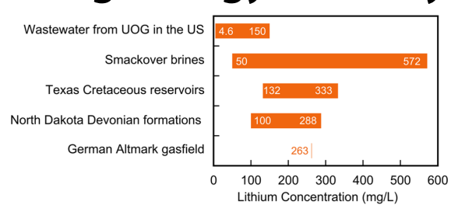
What counts as “enriched”
Formation waters typically include modified seawater
Li concentration seawater = 0.17 ppm
Highest oilfield brine concentration ~600 mg/L
Kumar et al 2019

Slide 16
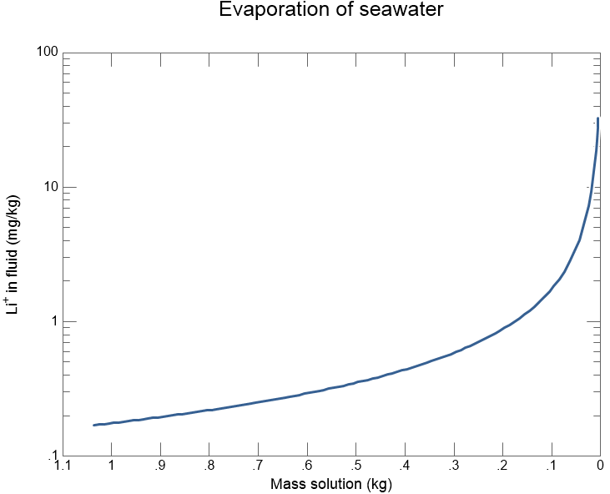
What counts as “enriched”
Theoretical evaporate 1L seawater with initial Li = 0.17 mg/kg
Evaporation would generate brine with <10 mg/kg Li
Halite saturated: Li ~ 1-2 mg/kg
Increasing evaporation

Slide 17
What counts as “enriched”
Theoretical evaporate 1L seawater with initial Li = 0.17 mg/L
Evaporation would generate brine with <10 mg/L Li
Halite saturated: Li ~ 1-2 mg/L
“Enriched” > 10 ppm Li
Increasing evaporation

Slide 18
What counts as “enriched”
Theoretical evaporate 1L seawater with initial Li = 0.17 mg/L
Evaporation would generate brine with <10 mg/L Li
Halite saturated: Li ~ 1-2 mg/L
Economic exploration threshold > 50 mg/L Li
Increasing evaporation

Slide 19
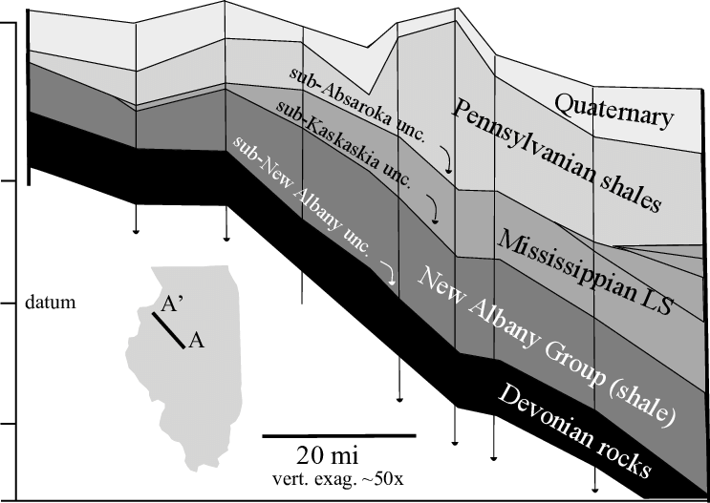
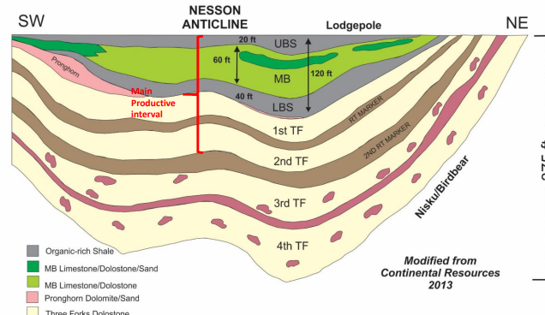
No lithium
Yes lithium

Slide 20
No lithium
Yes lithium
Not the first to investigate Li
Papers in 80’s-90’s have Li data, few address the origin of elevated Li
More recent work using additional analytical techniques

Slide 21
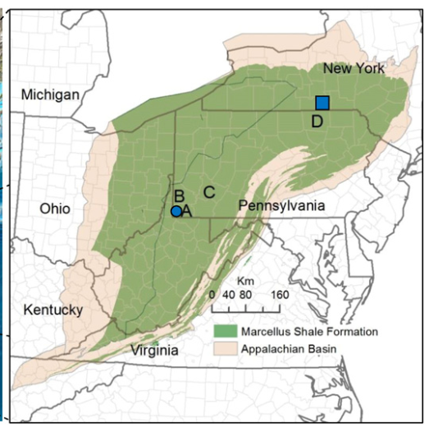
Marcellus Formation
~220 mg/L Li
Middle Devonian
Bimodal Li distribution in brine + rock
High Li in brine caused by alteration of volcanic ash (bentonites)
Partitioned into illite during diagenesis
~50 mg/L Li

Slide 22
Marcellus Formation
~220 mg/L Li
Middle Devonian
Bimodal Li distribution in brine + rock
High Li in brine caused by alteration of volcanic ash (bentonites)
Partitioned into illite during diagenesis
~50 mg/L Li

Slide 23
Marcellus Formation
~220 mg/L Li
Small sample set (n = 9)
Ash/bentonites reported, but Li content unknown
Similar average Li content between locations
Model based on 1 outlier value (85 ppm)
50 mg/Li in brine still ‘enriched’
‾X Li = 47 ppm
~50 mg/L Li
‾X Li = 43.5 ppm

Slide 24
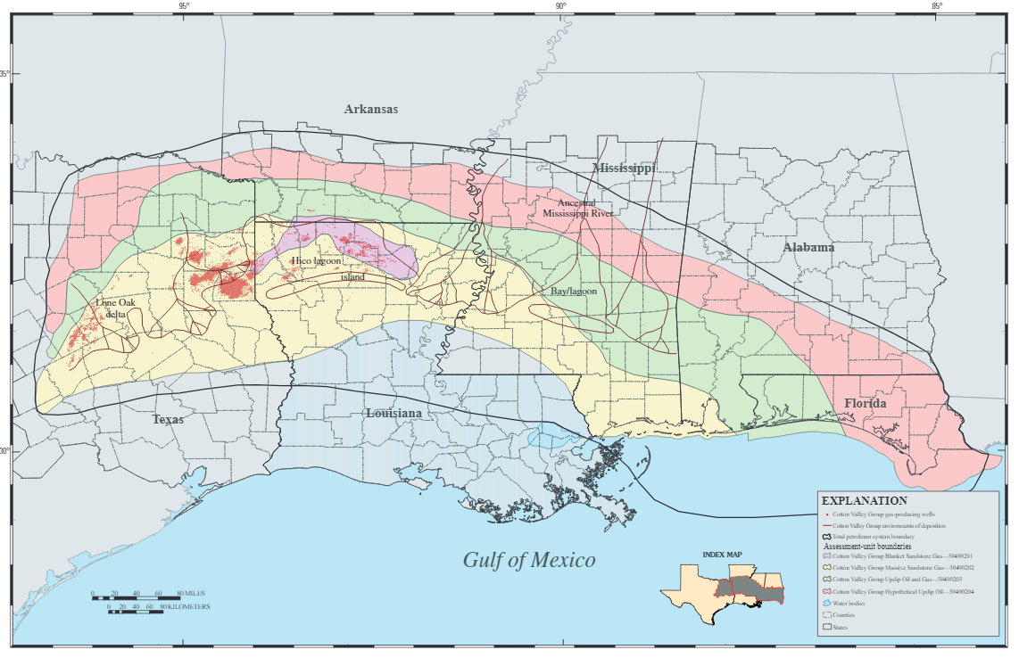
Smackover Formation
Jurassic
Bimodal Li distribution
High Li introduced through underlying red beds

Slide 25
Smackover Formation
Jurassic
Bimodal Li distribution
High Li introduced through underlying red beds

Slide 26
Smackover Formation
Jurassic
Bimodal Li distribution
High Li introduced through underlying red beds
How Li correlates with H₂S if sourced from an oxidized rock

Slide 27
Leduc + Nisku Formation
Middle-Late Devonian
Multiple Li distribution (appears reef dependent)
Li ~30 mg/L or ~70 mg/L
Li from dissolution K-salts or interaction with silicates or dolomitization
Leduc/Nisku Formation
(carbonates)
Marcellus

Slide 28
Bakken Formation
Late Devonian
~60 ppm Li
Unimodal Li content
Similar chemistry to Leduc/Nisku
No published model about Li
Leduc/Nisku Formation
(carbonates)
Bakken Formation (black shale)

Slide 29
Now what
Proposed either silicates or evaporites as origin of Li, mostly circumstantial evidence
The approach:
Investigate ‘high’ Li brines at Leduc/Nisku + Bakken Fm (w/ Shanshan Li – McS student)
Investigate lower Li brine (Ellerslie Formation, Cretaceous age - > 30 mg/L Li)
Petrographic work + in-situ analysis
Multivariate analysis

Slide 30
Multivariate analysis - PCA
~840 samples where >90% have Cl, Br, B, Na, K, Li, Ca, Mg, Sr and 85-75% have TDS, Ba, SO4 data
Includes siliciclastic and carbonate reservoirs from North America
Data from USGS Formation Water Database

Slide 31
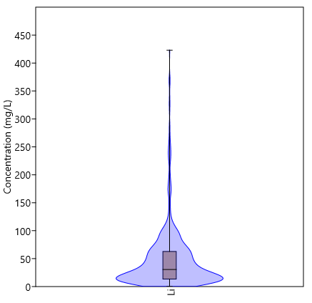
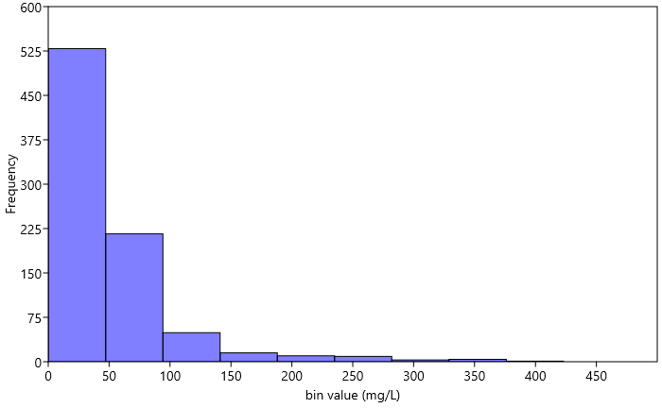
Multivariate analysis - PCA
~840 samples where >90% have Cl, Br, B, Na, K, Li, Ca, Mg, Sr and 85-75% have TDS, Ba, SO4 data
Includes siliciclastic and carbonate reservoirs from North America

Slide 32
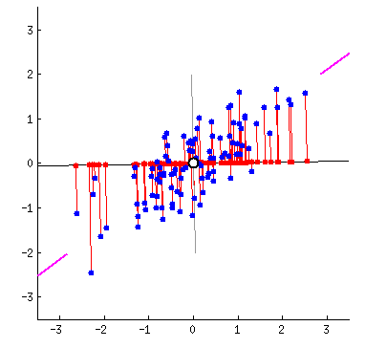
Principal component analysis
Dimension reduction technique
X number of variables reduced to few variables that contain most of the datasets variance
Computed Principal Component are linear sums of original variables
Project original variables as vectors onto principal component axis

Slide 33
Principal component analysis
PC1
Dimension reduction technique
X number of variables reduced to few variables that contain most of the datasets variance
Computed Principal Component are linear sums of original variables
Project original variables as vectors onto principal component axis
PC2

Slide 34
PCA Loadings*
53.2%
11.8%
10.5%
8.46%
5.67%
4.07%
2.03%
1.8%
1.41%
0.54%
0.34%
0.10%
* Do not worry, will not be going through all of this

Slide 35
PCA Loadings*
53.2%
11.8%
10.5%
8.46%
5.67%
4.07%
2.03%
1.8%
1.41%
0.54%
0.34%
0.10%
* Do not worry, will not be going through all of this

Slide 36
PCA Loadings*
53.2%
11.8%
10.5%
8.46%
5.67%
4.07%
2.03%
1.8%
1.41%
0.54%
0.34%
0.10%
* Do not worry, will not be going through all of this

Slide 37
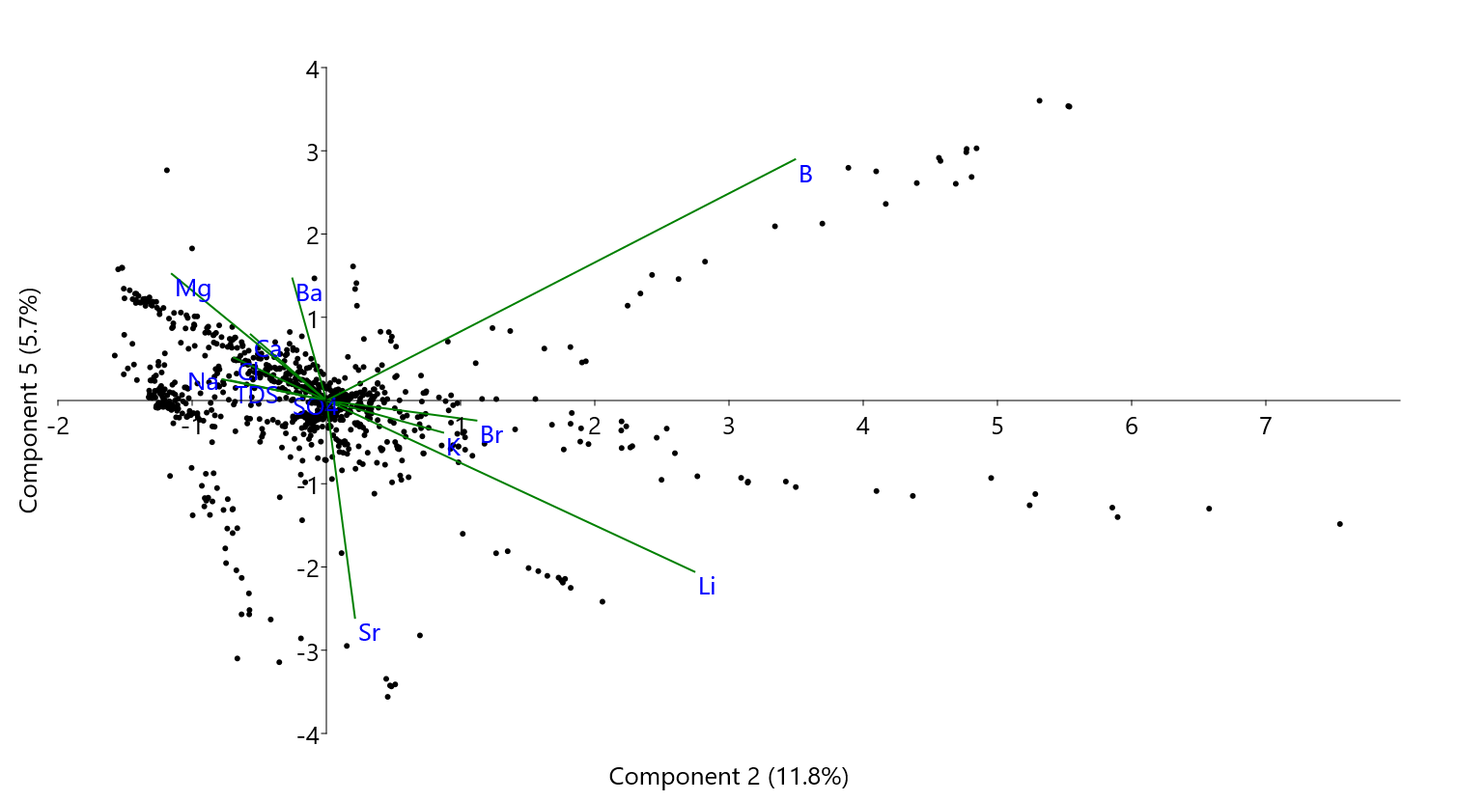
Angle between vectors = measure of variable correlation
-> zero angle = highest positive correlation
180° = highest negative correlation

Slide 38
Li highly correlated with K and Br. Moderately correlated to B and Sr.
B and Sr not correlated with each other

Slide 39
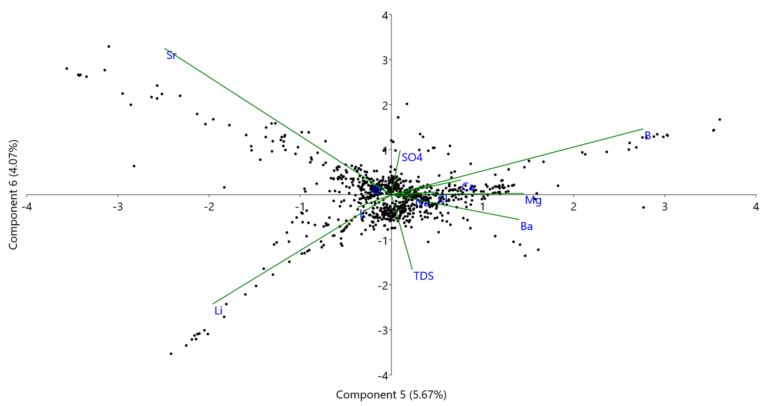
Li highly correlated with K and Br.
Negatively correlated with B.

Slide 42
High K/Br
Low K/Br

Slide 43
Bakken Formation – Late Devonian
Leduc/Nisku Formation – Late Devonian carbonates Alberta
Ellerslie Formation, sandy shale – Early Cretaceous Alberta

Slide 44
Bakken Formation – Late Devonian
Same/similar source of Li?
Leduc/Nisku Formation – Late Devonian carbonates Alberta
Ellerslie Formation, sandy shale – Early Cretaceous Alberta

Slide 45
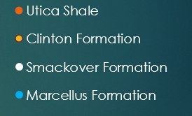
Marcellus Formation (south PA)
Utica shale
Marcellus Formation (central PA)
Clinton Formation
Smackover Formation

Slide 46
Source of K and Br
Potassium
Silicate minerals (suggested source of some Li)
Dissolution of K-salts (suggested source of Li)
Br
Dissolution/recrystallization carbonate/evaporite minerals
Organic matter

Slide 47
Source of K and Br
Potassium
Silicate minerals (suggested source of some Li)
Dissolution of K-salts (suggested source of Li)
Br
Dissolution/recrystallization carbonate minerals
Organic matter
Sr isotopes can be used to track water-rock interactions where pools of Sr have different ⁸⁷Sr/⁸⁶Sr values
⁸⁷Rb¹⁺ decays to ⁸⁷Sr²⁺
Isolated pools of Sr
⁸⁷Sr/⁸⁶Sr does not fractionate

Slide 48
Source of K and Br
K
⁸⁷Rb
Li⁺
K
Li⁺
Li⁺
⁸⁷Rb
⁸⁷Sr
⁸⁷Sr
Li⁺
Sr²⁺
Ca²⁺
K⁺
Cl⁻

Slide 49
Source of K and Br
K
⁸⁷Rb
Li⁺
K
Li⁺
Li⁺
⁸⁷Rb
⁸⁷Sr
⁸⁷Sr
Li⁺
Sr²⁺
Ca²⁺
K⁺
Cl⁻

Slide 50
Should produce positive correlation in data
⁸⁷Rb
K
Li⁺
Na
⁸⁷Sr
⁸⁷Sr
Li⁺
Adsorption sites
Edge site
Interlayer sites
Partial dissolution
exchange
Br
Ca²⁺
Mg²⁺

Slide 52
MAximum Sr Isotope of Basinal Shale (MASIRBAS; Machel et al 1999) unknown Li content
Weighted Sr-isotopic composition from formation-water interaction with shale
(i.e., Sr from soluble salts, carbonates + adsorbed ions)
Value only applicable to Devonian (or younger) in the WCSB
Devonian Seawater
1/Li = ~10

Slide 53
Data sources: Bakken = Peterman et al 2017; Ellerslie, Leduc, Nisku = Huff 2016

Slide 54
Data sources: Bakken = Peterman et al 2017; Ellerslie, Leduc, Nisku = Huff 2016

Slide 55
A
A
B
B
Data sources: Bakken = Peterman et al 2017; Ellerslie, Leduc, Nisku = Huff 2016

Slide 56
Heaviest Sr < MASIRBAS
Intrabasinal shales
Li ~ 10 to 25 ppm
A
A
B
B
Data sources: Bakken = Peterman et al 2017; Ellerslie, Leduc, Nisku = Huff 2016

Slide 57
Heaviest Sr < MASIRBAS
Intrabasinal shales
Li ~ 10 to 25 ppm
A
A
B
B
Evaporated Devonian Seawater
Data sources: Bakken = Peterman et al 2017; Ellerslie, Leduc, Nisku = Huff 2016

Slide 58
A
A
B
Due to difference in depositional conditions
B
Data sources: Bakken = Peterman et al 2017; Ellerslie, Leduc, Nisku = Huff 2016

Slide 59
Li/Al average shale= ~ 7.46 (ppm/wt%)
Li/Al of the Bakken Formation = ~ 20 (ppm/wt%)
Li/Al of the Ellersile Formation = ~ 6.5 (ppm/wt%)
Data sources: Bakken = Peterman et al 2017; Ellerslie, Leduc, Nisku = Huff 2016

Slide 60
Data sources: Bakken = Peterman et al 2017; Ellerslie, Leduc, Nisku = Huff 2016

Slide 61
~120 km N/S
~30km east
Data sources: Bakken = Peterman et al 2017; Ellerslie, Leduc, Nisku = Huff 2016

Slide 62
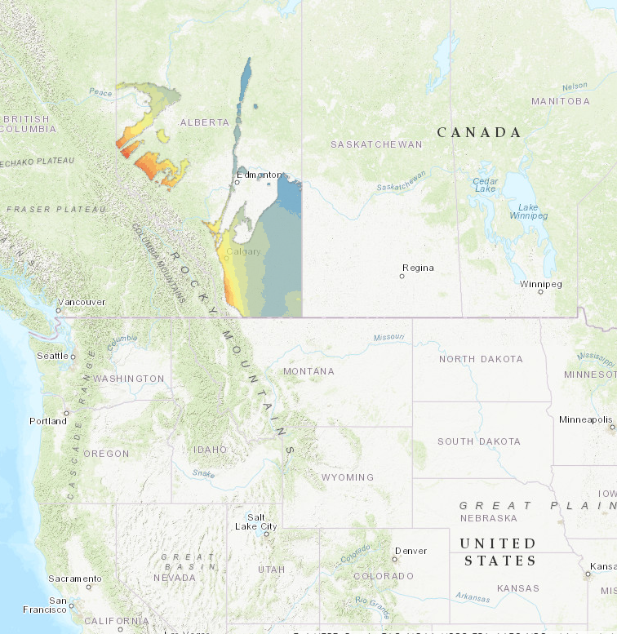
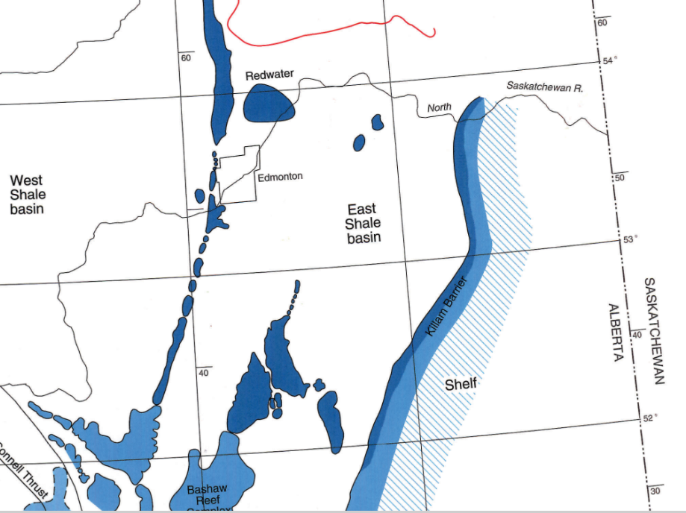
~120 km N/S
~30km east
Data sources: Bakken = Peterman et al 2017; Ellerslie, Leduc, Nisku = Huff 2016

Slide 63
Leduc
~120 km N/S
Duhamel
~30km east
Data sources: Bakken = Peterman et al 2017; Ellerslie, Leduc, Nisku = Huff 2016

Slide 64
Redwater
Data sources: Bakken = Peterman et al 2017; Ellerslie, Leduc, Nisku = Huff 2016

Slide 65
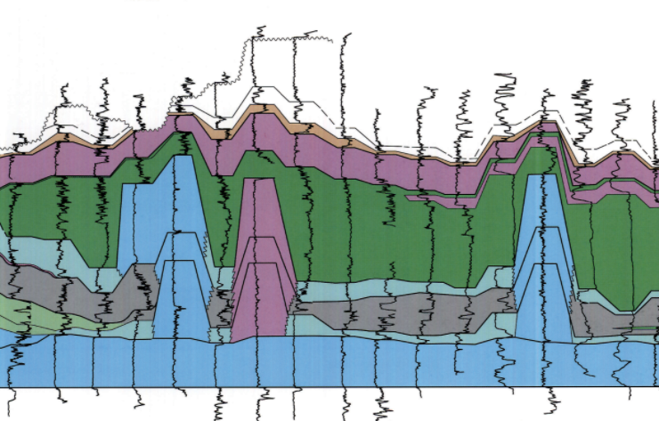
N
Leduc
S
Duhamel
Redwater
Nisku
Data sources: Bakken = Peterman et al 2017; Ellerslie, Leduc, Nisku = Huff 2016

Slide 66
Data sources: Bakken = Peterman et al 2017; Ellerslie, Leduc, Nisku = Huff 2016

Slide 67
Redwater-Leduc
East-west flow
R² = 0.95
Duhamel-Leduc
northward flow
R² = 0.82
Data sources: Bakken = Peterman et al 2017; Ellerslie, Leduc, Nisku = Huff 2016

Slide 68
R² = 0.95
R² = 0.82
Data sources: Bakken = Peterman et al 2017; Ellerslie, Leduc, Nisku = Huff 2016

Slide 69
sedimentary siliciclastics
?
Mysterious fluid of magical origins
Seawater Sr-isotopes
Li ~ 100 mg/L
Devonian seawater
Data sources: Bakken = Peterman et al 2017; Ellerslie, Leduc, Nisku = Huff 2016

Slide 70
Data: Smackover: Moldovanyi et al 1992, 1993; too few for Marcellus, only a handful for Utica shale

Slide 71
Samples nearer fault systems
Data: Smackover: Moldovanyi et al 1992, 1993; too few for Marcellus, only a handful for Utica shale

Slide 72
Data: Smackover: Moldovanyi et al 1992, 1993; too few for Marcellus, only a handful for Utica shale

Slide 73
A
B
Data: Smackover: Moldovanyi et al 1992, 1993; too few for Marcellus, only a handful for Utica shale

Slide 74
Less expandable
Leaching sedimentary clays
More expandable
Jurassic Seawater -> 1/Li = ~ 10

Slide 75
Bossier Shale
Louann halite's/anhydrites (Alabama)
Jurassic Seawater -> 1/Li = ~ 10

Slide 76
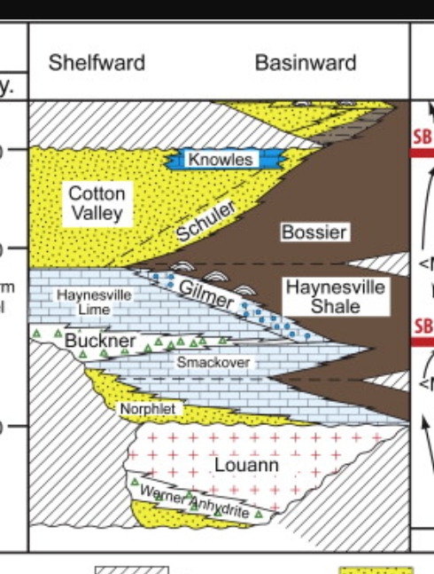
Bossier Shale
Louann halite's/anhydrites (Alabama)
Jurassic Seawater -> 1/Li = ~ 10

Slide 77
Bossier Shale
Louann halite's/anhydrites (Alabama)
Jurassic Seawater -> 1/Li = ~ 10

Slide 78
Bossier Shale
C
Louann halite's/anhydrites (Alabama)
B
A
Jurassic Seawater -> 1/Li = ~ 10

Slide 79
Bossier Shale
Jurassic Seawater -> 1/Li = ~ 10

Slide 80
Silicate Minerals as a Li source
Crystalline basement
vs
sedimentary rocks

Slide 81
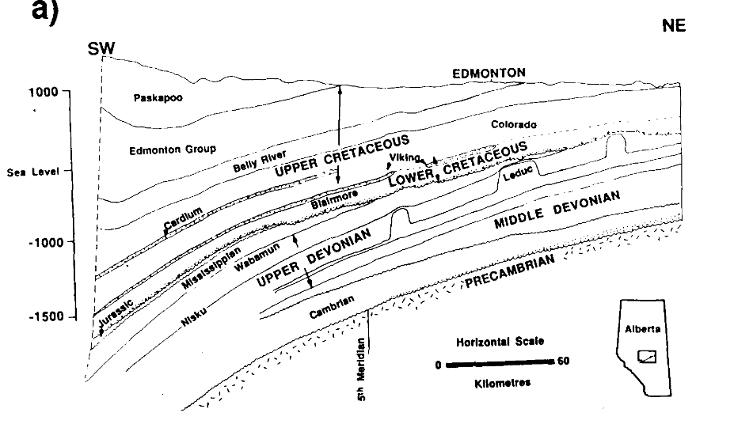
Silicate Minerals as a Li source
Crystalline basement
vs
sedimentary rocks
Connolly et al 1990

Slide 82
Silicate Minerals as a Li source
Average ⁸⁷Sr/⁸⁶Sr = 0.709
Basinal shale = 0.712
Crystalline basement
vs
sedimentary rocks
Connolly et al 1990

Slide 83
Silicate Minerals as a Li source
Average ⁸⁷Sr/⁸⁶Sr = 0.709
Basinal shale = 0.712
Crystalline basement
vs
sedimentary rocks
⁸⁷Sr/⁸⁶Sr ~1
⁸⁷Sr/⁸⁶Sr ~0.76
Connolly et al 1990

Slide 84
Silicate Minerals as a Li source
Average ⁸⁷Sr/⁸⁶Sr = 0.709
Basinal shale = 0.712
Crystalline basement
vs
sedimentary rocks
⁸⁷Sr/⁸⁶Sr ~1
⁸⁷Sr/⁸⁶Sr ~0.76
Connolly et al 1990

Slide 85
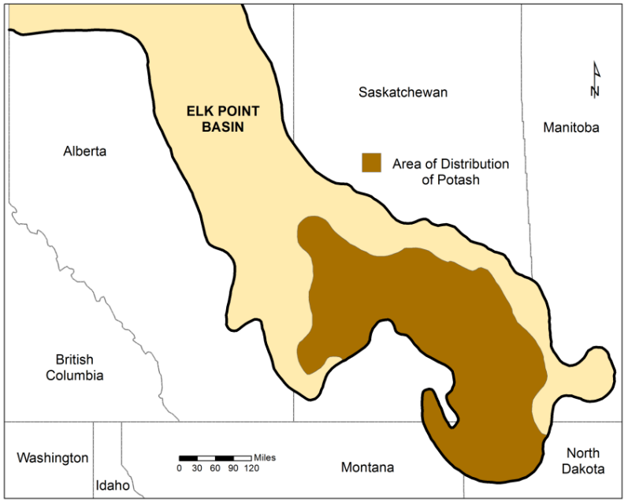
Evaporites as a Li source
Edmonton

Slide 86
Evaporites as a Li source
Salt core
30/30 = < 1 ppm
Salt solution < 1 ppm Li

Slide 87
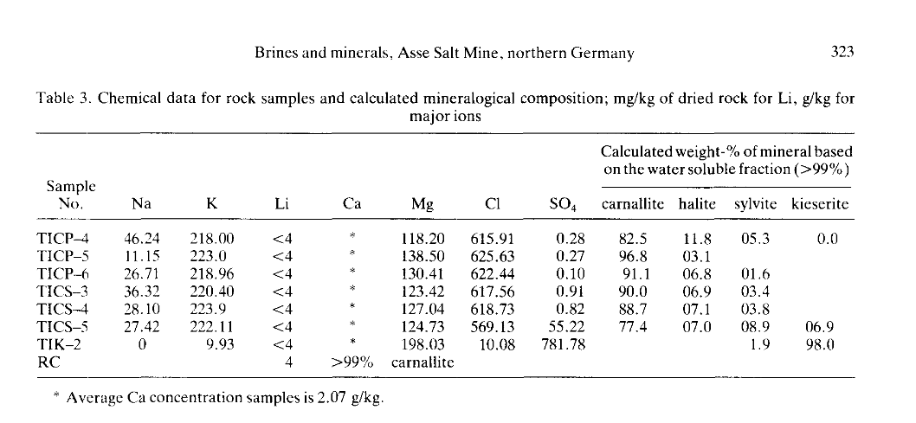
Evaporites as a Li source
Nishri et al 1988
Brine
Salt Samples

Slide 88
Evaporites as a Li source
Nishri et al 1988
Brine
Salt Samples
Tentatively concluded lithium soured from overlying/intercalculating sediments

Slide 89
High K/Br
Low K/Br

Slide 90
High K/Br
Bakken Formation
K-enriched
Normal Br
Normal Sr
Ca enriched
Mg depleted
Interpretation
Altered feldspars
No salt contribution
dolomitization
Low K/Br

Slide 91
High K/Br
Smackover Formation
K depleted
Br enrichment
Sr enrichment
Interpretation
Illitization
Dissolved salt contribution
Low K/Br

Slide 92
High K/Br
Leduc/Nisku Mysterious 3rd fluid =
Br-Li distribution coefficients in K-salts?
No Br (or Sr)-enrichment
Alteration of volcanic ash?
Not enough ash?
Highly evolved trace detrital content?
Limited radiogenic Sr-isotopes
Low K/Br

Slide 93
Why do some basins have Li-enriched waters?
Source of Li
Seawater
Evaporates
Silicate minerals
Detrital? Authigenic?
Clays? Feldspars?
Availability of Li
Participates in mineral reactions or locked in resistant minerals
The Lithium conundrum:
If Li is sourced from host rock lithology, depending on the fluid/rock ratio, and how effective the Li extraction process is, the whole-rock Li values may be misleading.

Slide 94
Why do some basins have Li-enriched waters?
Source of Li
Seawater
Evaporates
Silicate minerals
Detrital? Authigenic?
Clays? Feldspars?
Availability of Li
Participates in mineral reactions or locked in resistant minerals
Future work:
Petrographic mineral paragenesis of source rocks combined with mineral chemistry (EMPA + LA-ICPMS).
Leduc/Nisku, Ellerslie, Bakken, Smackover

Slide 95
Why do some basins have Li-enriched waters?
Source of Li
Seawater
Evaporates
Silicate minerals
Detrital? Authigenic?
Clays? Feldspars?
Availability of Li
Participates in mineral reactions or locked in resistant minerals
Source rock with X fluid/rock ratio, Y₁ mineral components of Z₁ composition; then some set of conditions (e.g., fO₂, pH, (H₄SiO₄), temp) would lead to (Y₁)% dissolution and Y₂ authigenic precipitation of Z₂ composition ->
Formation water with a predicable chemistry.

