Slide 1


Geothermal Investigation of Southern Crockett County,
Val Verde Basin, West Texas
Matt Uddenberg & Colgan Smith
Bureau of Economic Geology at Austin

Slide 2
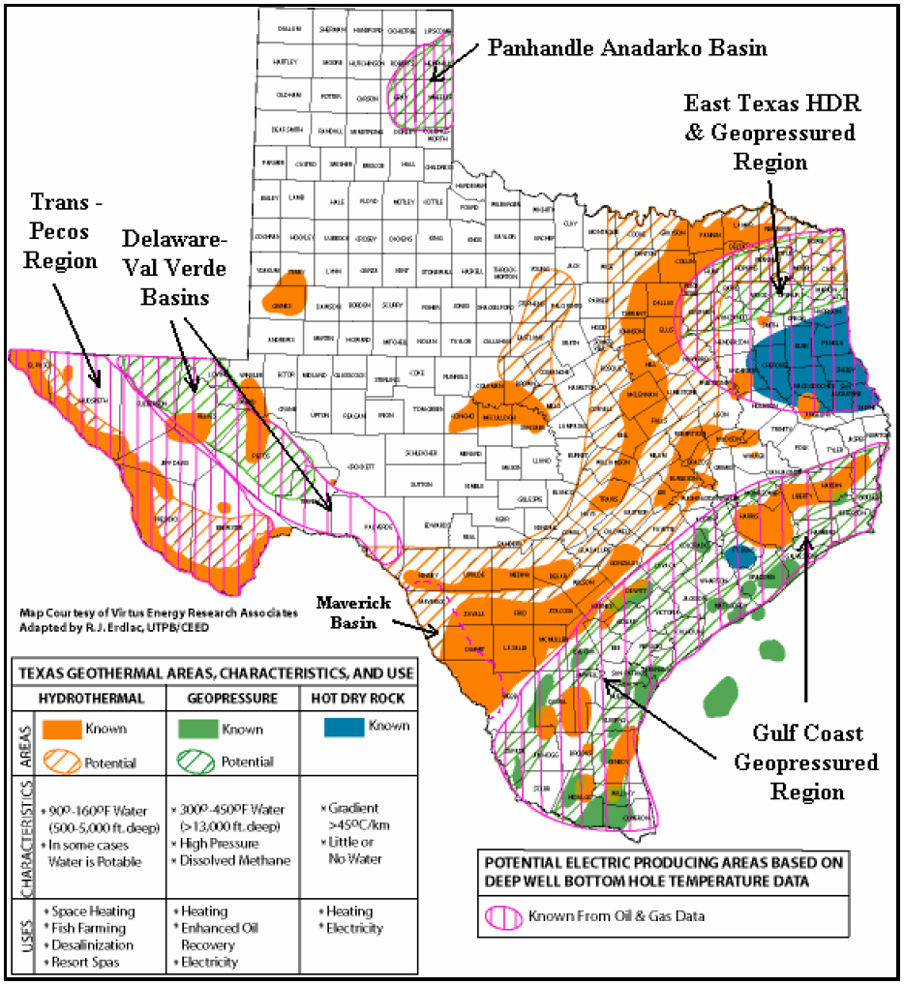
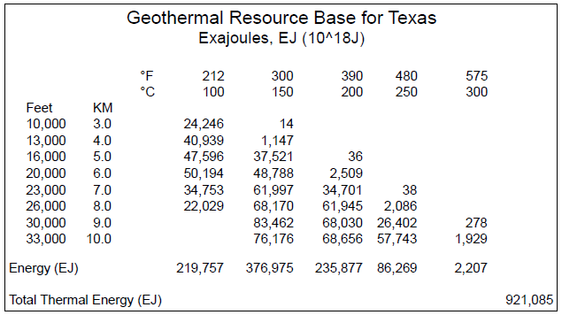
Texas Geothermal Resources
Majority of resources in Texas discovered as a result of O&G exploration and production.
Enormous amount of thermal energy stored in the subsurface.
921,085 EJ = 2.63*10^17 B.O.E. (263 quadrillion Barrels of Oil Equivalent)
= 1.53*10^24 BTU
= 2.60*10^24 MWh
Texas Renewable Energy Assessment, 2008
Erdlac, et al., 2007

Slide 3
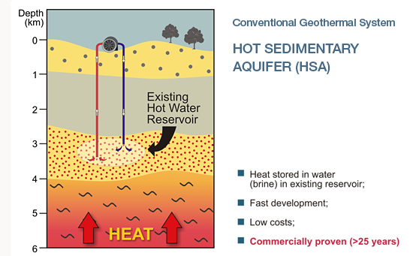

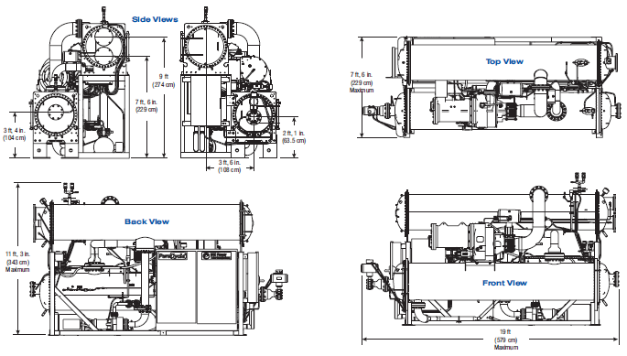
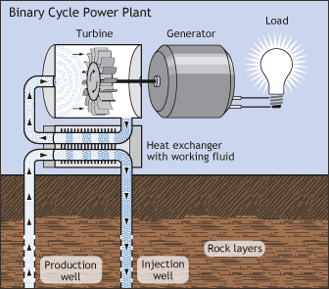
High efficiency Organic Rankine Cycle Binary Turbine, designed by Pratt and Whitney.
Temperatures ranging between 220 and 360 ˚F.
Uses secondary fluid with a lower flash temperature; closed loop system.
Pratt & Whitney Pure Cycle 280 kW Unit

Slide 4
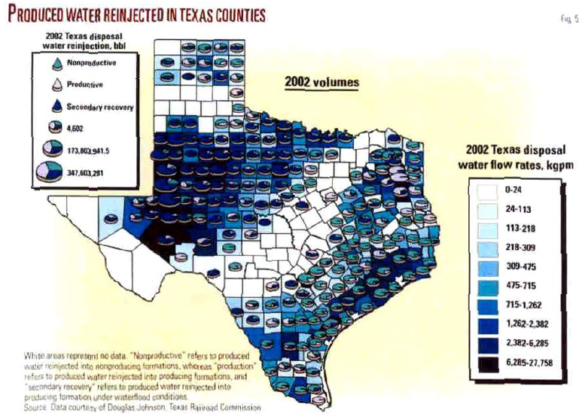
Untapped Potential
Produced water from oil and gas fields is reinjected to the subsurface.
This water is often hot enough to use a geothermal binary turbine.
At the very least there could be enough potential power to cover the energy needs of both pumping and injection programs within a oil or gas field.
Once the hydrocarbon field has expired it could be converted to a geothermal field with much of the existing infrastructure already in place.
Source: McKenna, et al., 2005

Slide 5
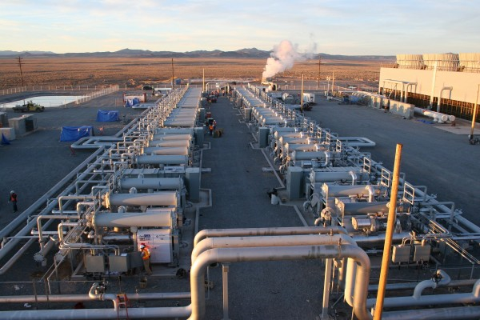
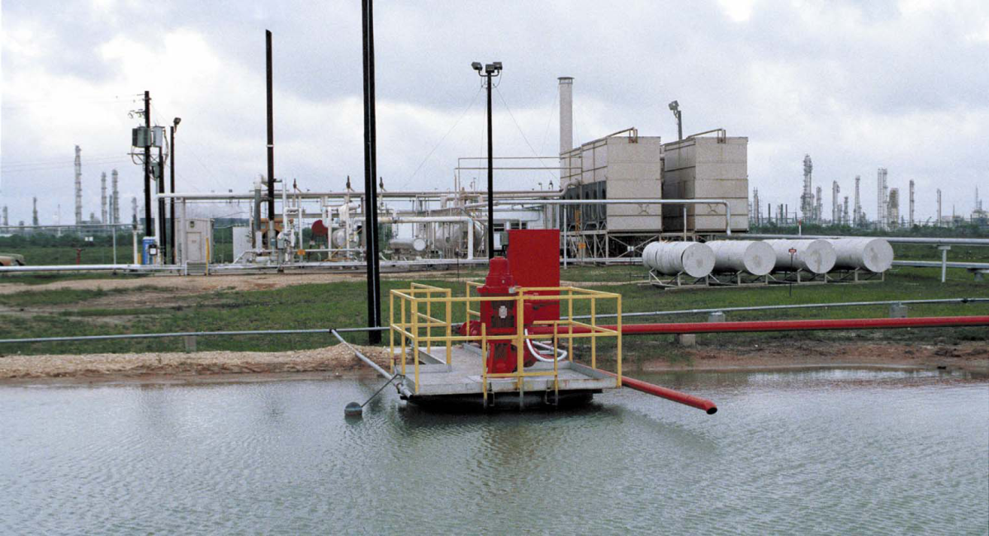
Online Small/Medium Scale Geothermal Projects
Soda Lake (12 MW) and Jersey Valley (15 MW) in Nevada.
Lightning Dock (15MW) in New Mexico
Thermo 2 (26MW) in Utah
These are all vastly different geothermal environments than what we are investigating.
Pleasant Bayou No. 2, Texas Gulf Coast
Geothermal resource assessment conducted by the U.S. Department of Energy in 1980’s.
Was the first successful binary system to produce energy from a deep sedimentary basin.
Temperature of brine was ~300 ˚F, and flow rates were ~10,000 bbl/day.
This plant operated for over a year and produced 1 MW from a single well.
Source: T. D. Riney, 1991

Slide 6
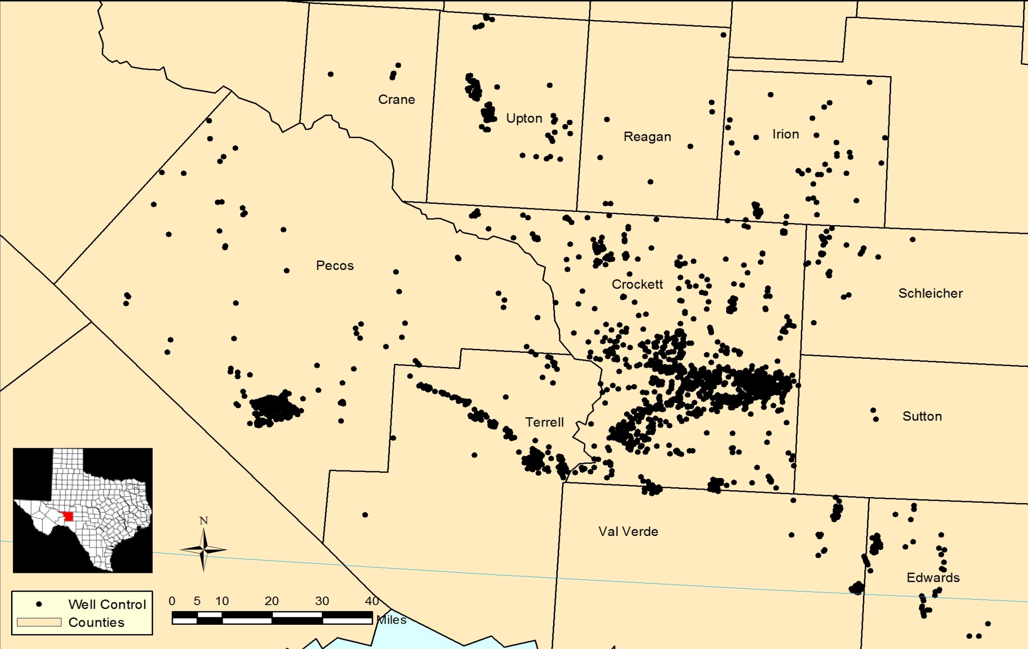
O&G Well Locations with BHT’s

Slide 7
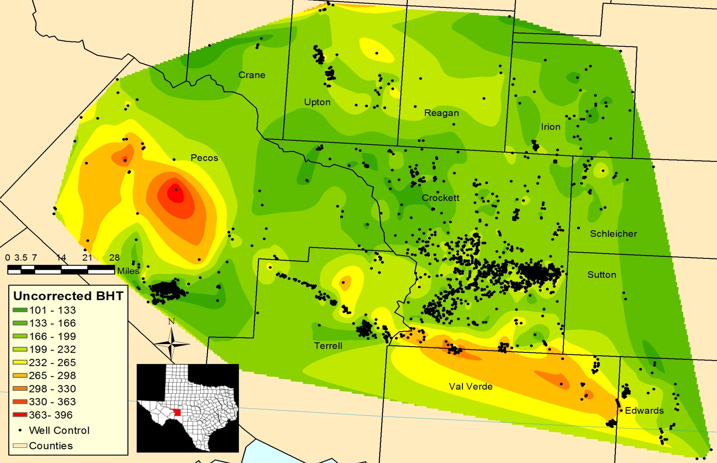
Uncorrected BHT’s

Slide 8
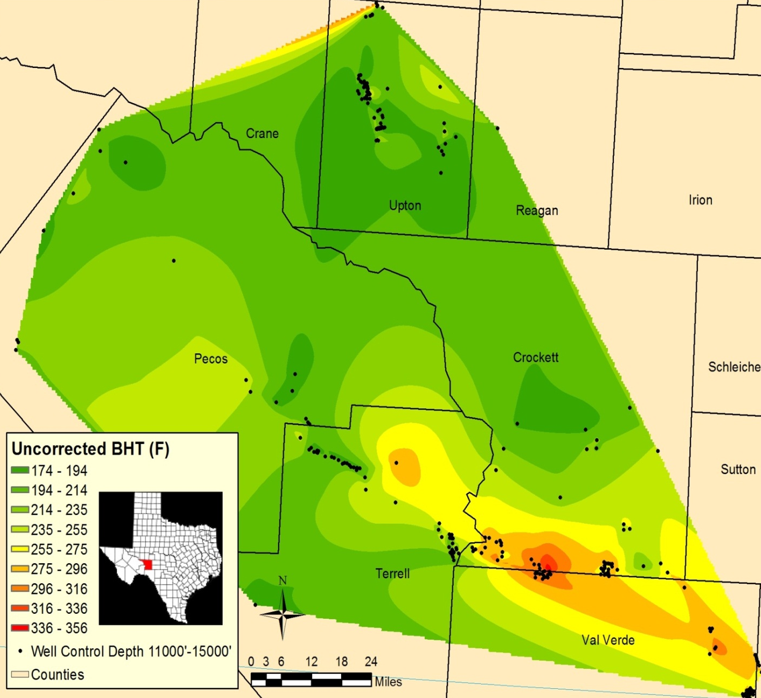
Uncorrected BHT’s between 11,000’-15,000’
High temperature anomaly in southern Crockett/northern Val Verde Counties.
Will O field (blue oval), has produced 41,000,000 MCF of Gas from 1993-2011 (RRC Records).

Slide 9
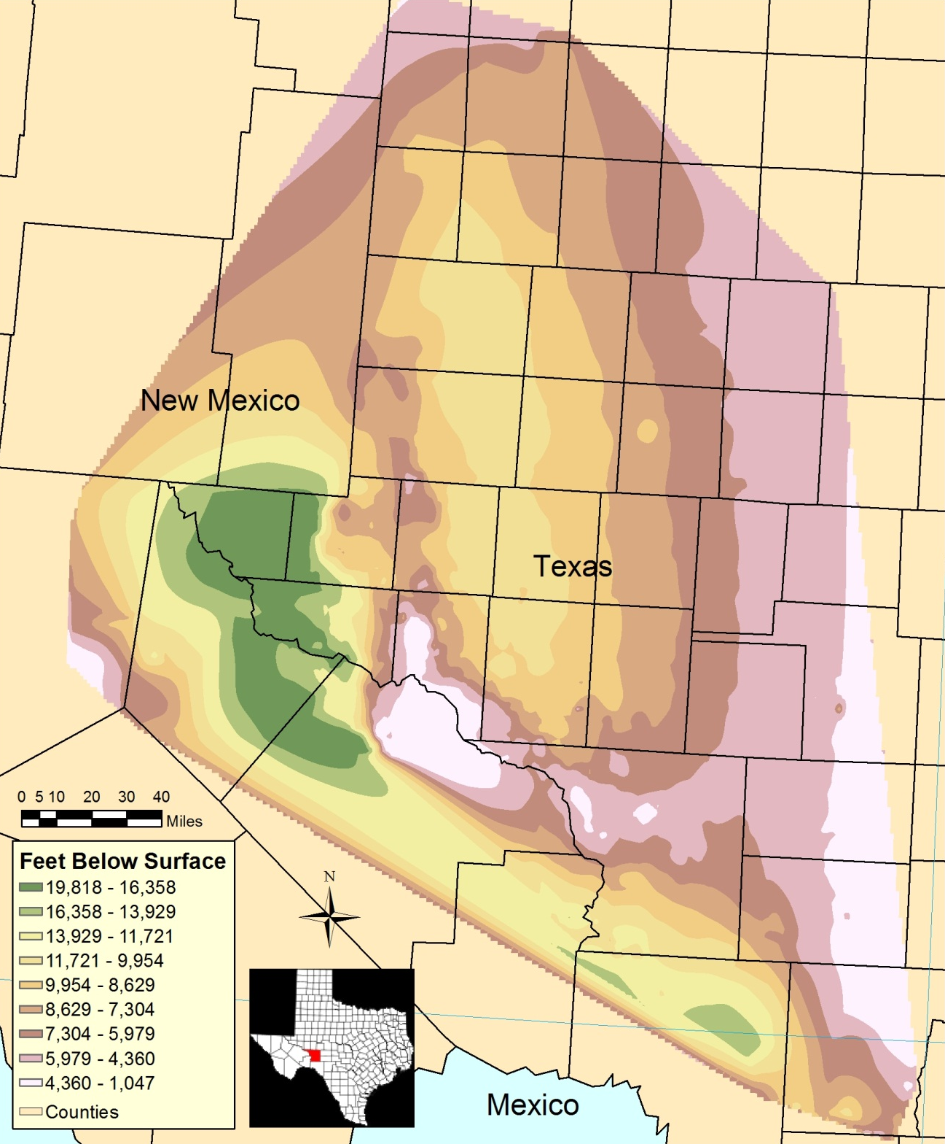
Depth of Ellenburger Surface
Structural surface for the Ellenburger group of Permian Basin, West Texas (BEG).
Southern Crockett County, Ellenburger surface dips 7˚ SW in area of interest (Blue Oval).
Top of Ellenburger is ~14,000’ at target area (Red Star).

Slide 10
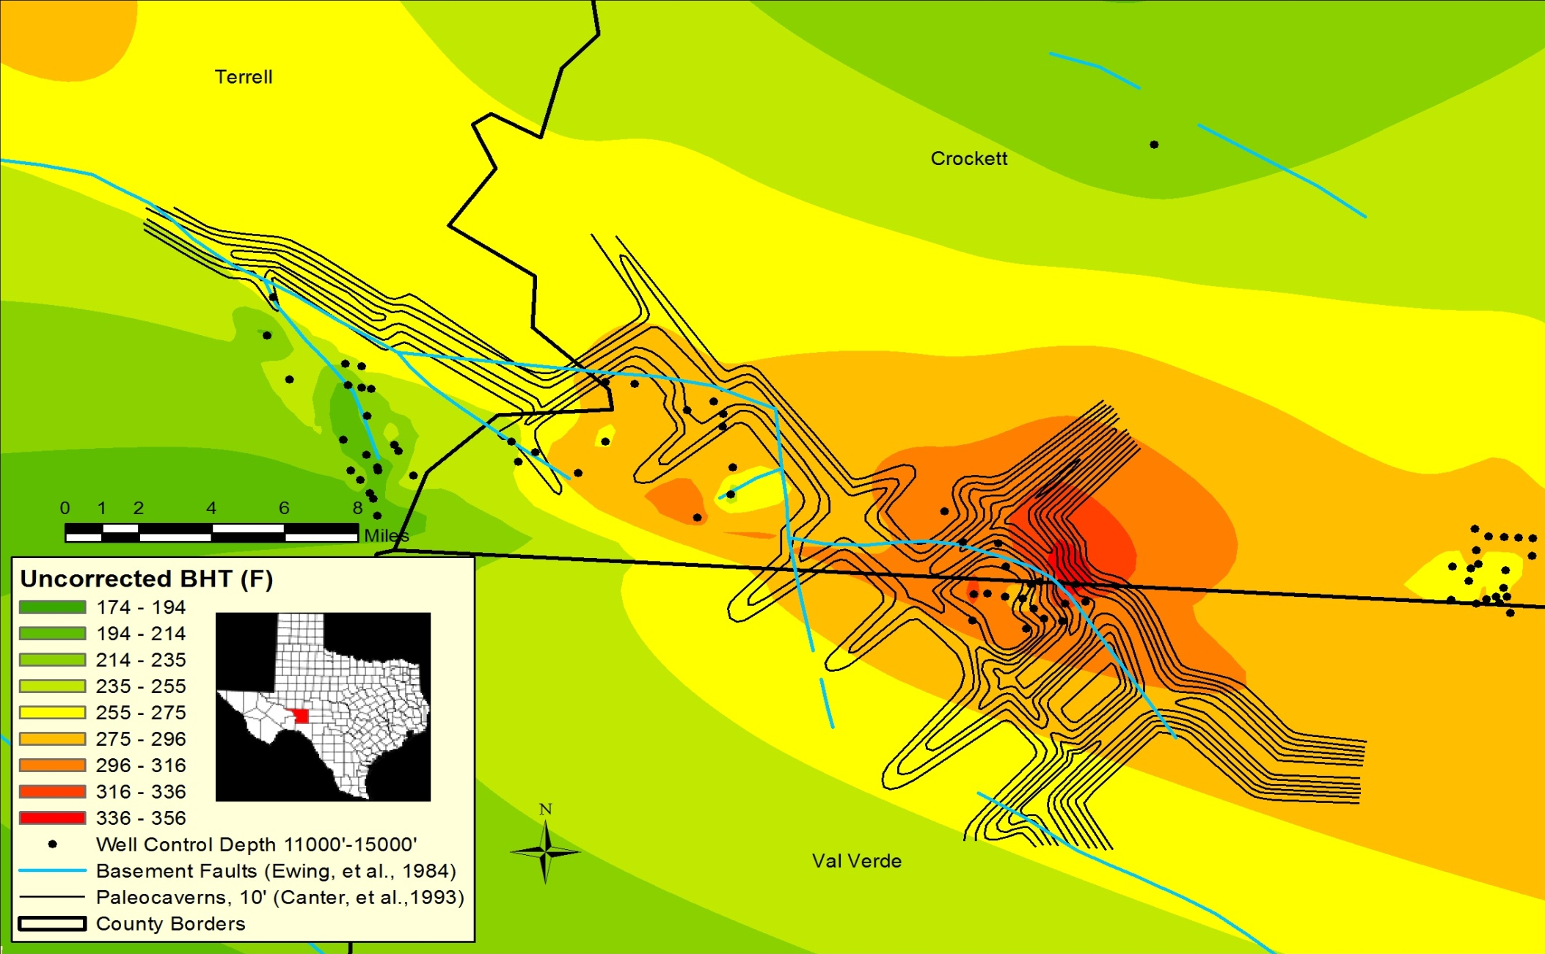
Ellenburger Paleocaverns Intersecting Will O Field, Southern Crockett County

Slide 11
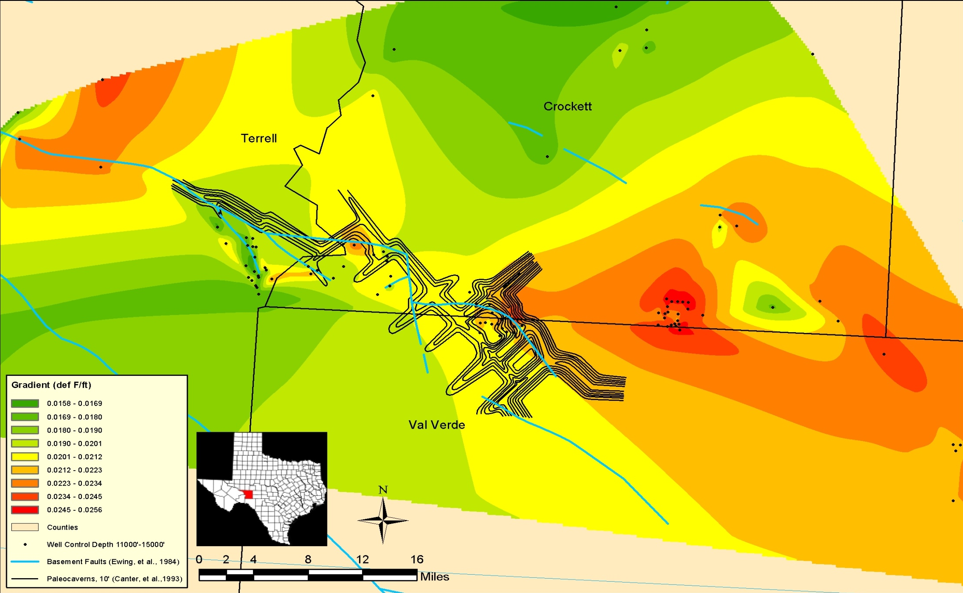
Uncorrected Temperature Gradient

Slide 12
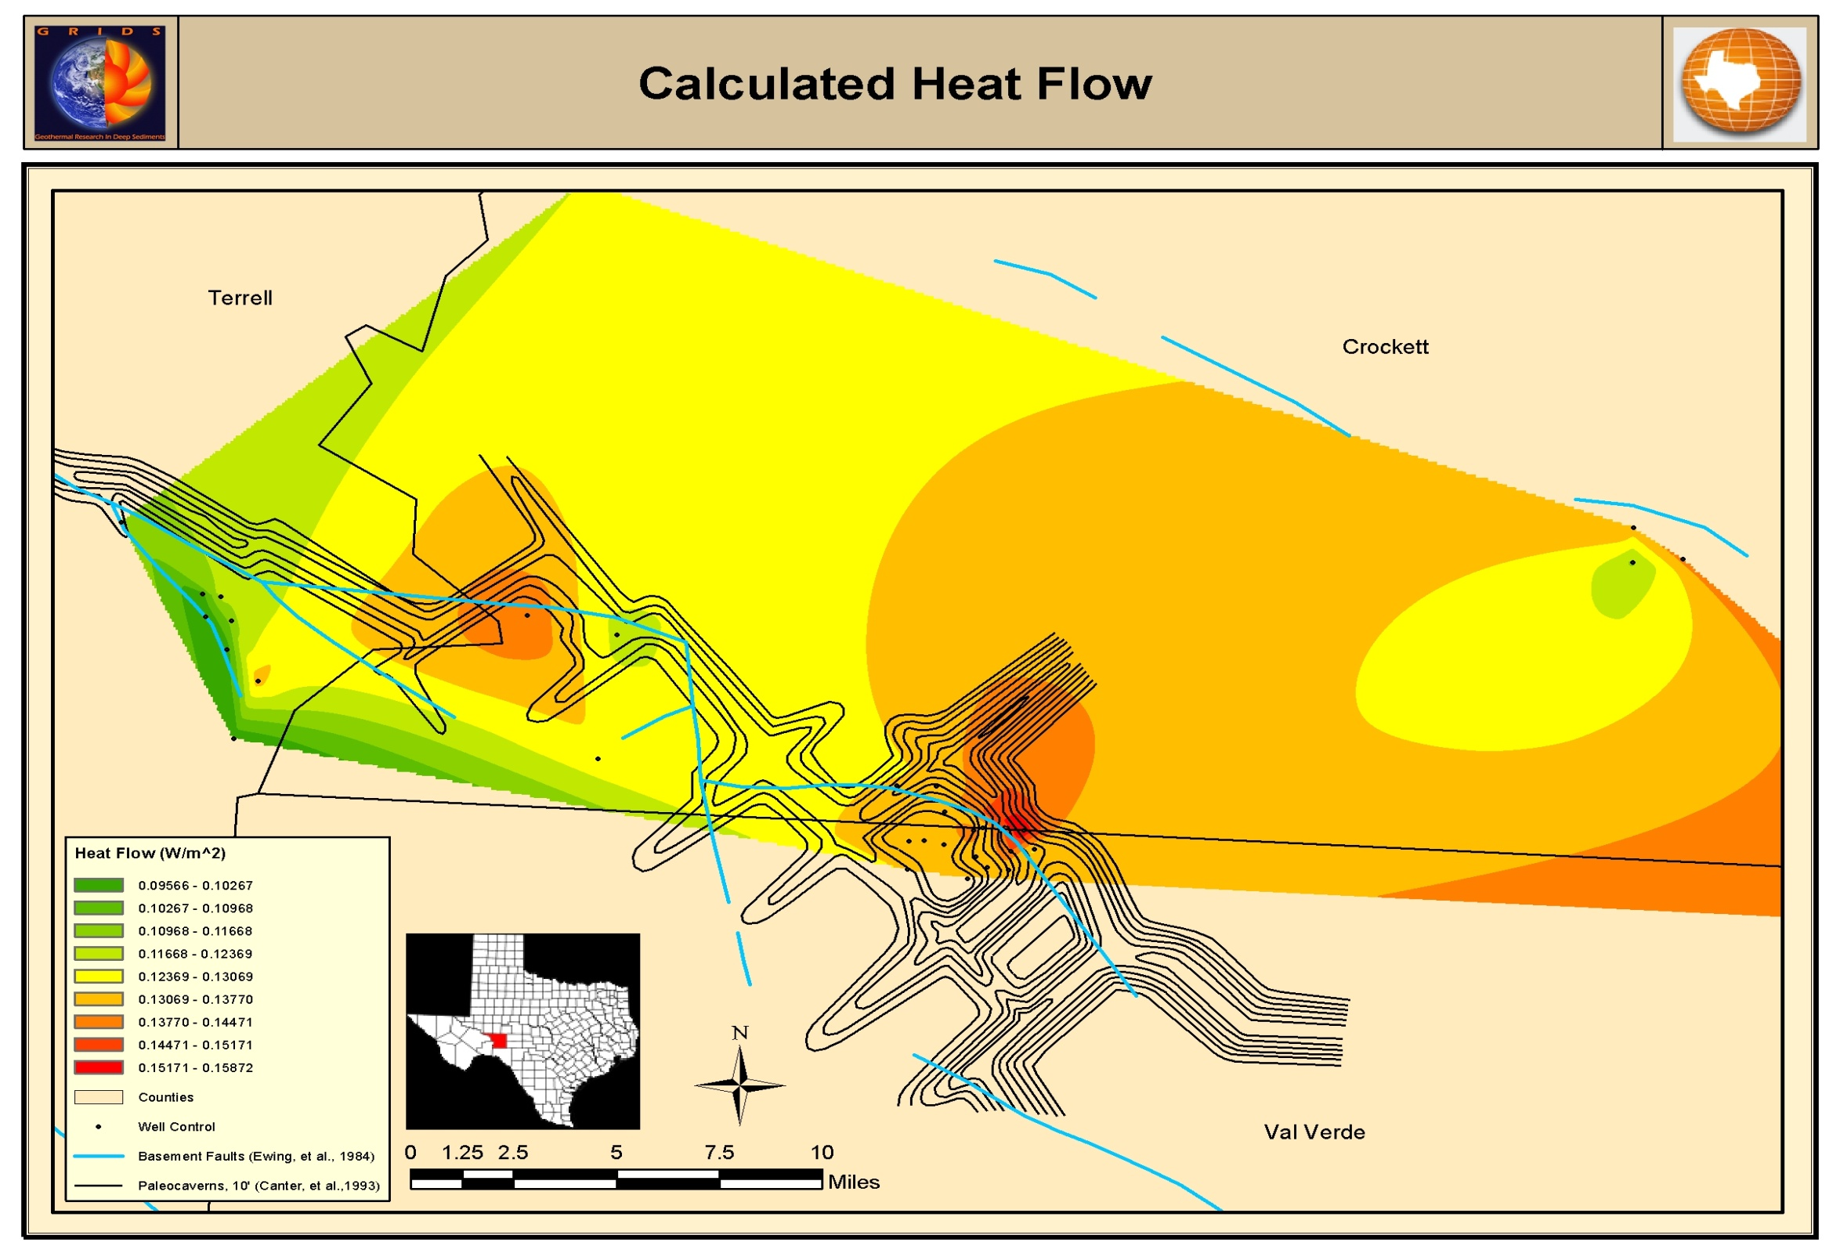
Heat Flow

Slide 13
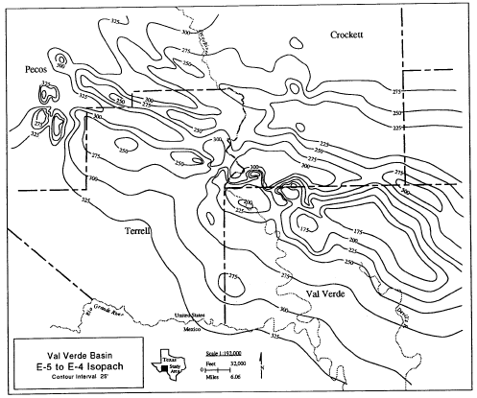
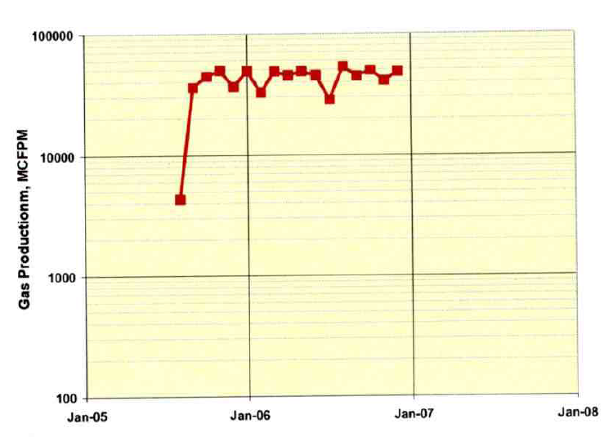
Ellenburger E-5 Isopach Map
Canter, et al., (1993) created an isopach map for the E-5 interval in the Ellenburger.
Thickness of Formation hosting paleocaverns ranges between 200 and 300 feet (red oval).
Gas operators working this field have done multiple stages of acid fracs to increase permeability in the pay zone.
Post single stage treatment of acid frac- production values increased by an order of magnitude.
Swain, et al., 2007
Canter, et al., 1993

Slide 14
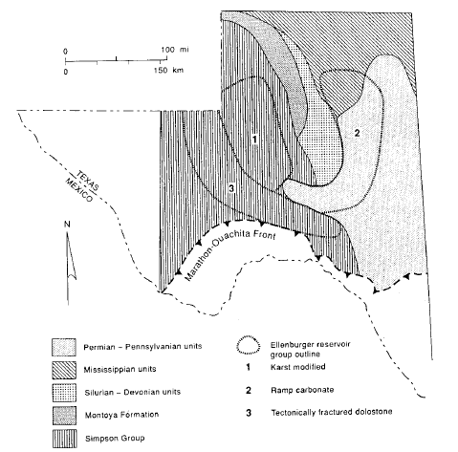
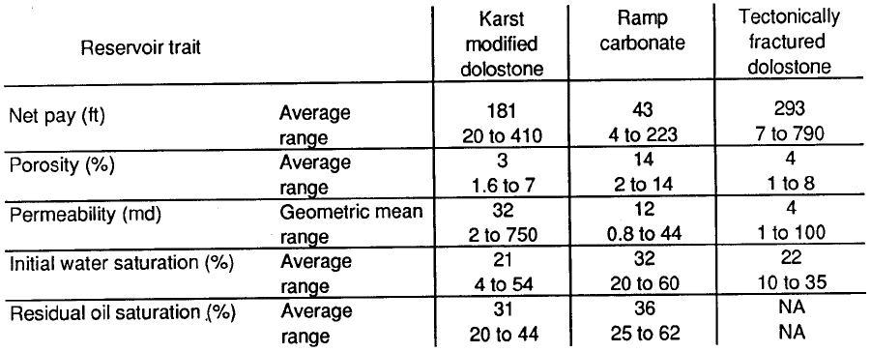

Reservoir Characteristics
Proximity to basement fault and paleocavern, we expect secondary porosity to be relatively high in this field.
Permeabilities range by several orders of magnitude in the Ellenburger, but we assumed a conservative average of 75 md.
We assumed an average water saturation of 22%.
We used the mean reservoir temperature of 312˚F from our BHT dataset.
Source: Erdlac, et al., 2007
Source: Hotlz and Kerans, 1992

Slide 15

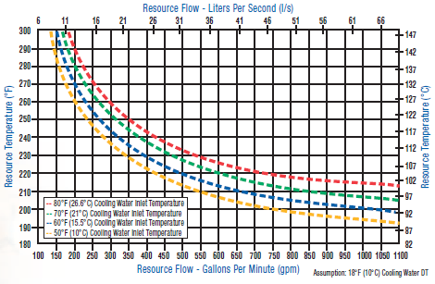
Flow Rates for Binary Cycle
High confidence in reservoir due to O&G industry and various academic studies.
Many reservoir characteristics have been published and well logs from this field can be acquired.
Estimated flow rates for given resource temperature provided by Pratt and Whitney.
Necessary flow rates for Crockett county geothermal field are 120-175 gpm (~4,000-6,000 bbl/day) for a single Pure Cycle 280 kW unit.
Source: Pratt & Whitney Pure Cycle Power System Brochure

Slide 16
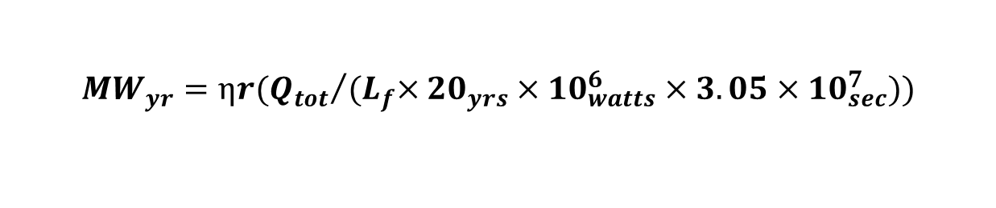
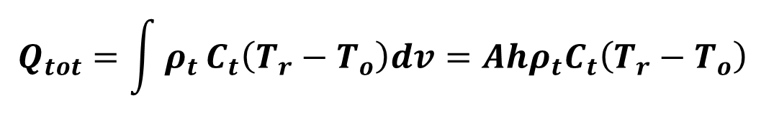
Estimate of Geothermal Resource
The stored heat method was used to estimate the potential reserves for the indentified field in southern Crockett county.
$$Q_{tot}=\int{ρ_{t}}C_{t}\left(T_{r}−T_{o}\right)dv=Ahρ_{t}C_{t}\left(T_{r}−T_{o}\right)$$
MW_{yr} is predicted using the equation below and plugging in the value of Q_{tot} from above.
$${MW}_{yr}=ηr({Q_{tot}}/{{(L}_{f}×{20}_{yrs}×{10}_{watts}^{6}×3.05×{10}_{sec}^{7}))}$$
MW_{yr} is calculated using a 20 year lifespan for the facility, which is the average lifespan of a binary unit.

Slide 17
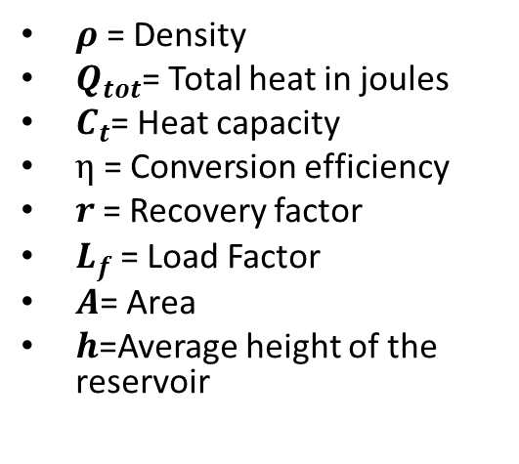
Measuring Uncertainty
$ρ$= Density
$Q_{tot}$= Total heat in joules
$C_{t}$= Heat capacity
$η$= Conversion efficiency
$r$= Recovery factor
$L_{f}$= Load Factor
$A$= Area
$h$=Average height of the reservoir
Where there were a range of values for a given variable a distribution was determined and used to run a Monte Carlo simulation to give probabilities for a range of electrical output.
An economic model called the Geothermal Electricity Technology Evaluation Model (GETEM), developed by the Idaho National Laboratory, was used to determine the cost of electricity in a good case, bad case, and base case scenario.

Slide 18
Important Inputs
η- Calculated to be 31% with a deviation of the mean of .7%. These numbers were chosen from research into second law efficiency performances from past binary projects (R. DiPippo, 2004).
r- Typical historical values have a mean of 10% with a range from 7% to 40% (M. A. Grant, 2011).
A- Area approximated by using arc GIS to calculate the areal extent of the known fractured reservoir. This value came out to be approximately 10 Km². A guess was made as to the deviation by assuming that area of the reservoir could be off by as much as +/-30%.
H- Average height for the reservoir in this region is 250 ft and ranges between 200 ft to 300 ft (Canter et al. 1993).
K- Ranges several orders of magnitude. We estimated a conservative value for our chosen fractured reservoir of 75 md (Erdlac, et al., 2007).

Slide 19
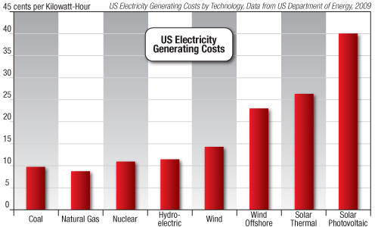
Estimate of Cost
Scenario | Cost: ¢/kWh
Good Case | 15.42
Base Case | 20.86
Bad Case | 60.33
Our estimated price ranges in ¢/kWh for the Crockett county geothermal field for good, base and bad case scenarios.
Our estimates fit closely with the cost of competitive renewable resources, but are still more expensive then natural gas or coal.
http://www.energytribune.com/articles.cfm/5131/Wind-Energys-House-of-Cards

Slide 20
Base Case Scenario Cost Profile
Exploration and Confirmation
Wells in Field, after Confirmation phase
Field, Other (pipes, pumps, well stimulation, make up costs, etc.)
Energy Conversion System
Royalty
Contingency
Drilling is 30-40% of the total cost for a geothermal power plant.
Once gas production wanes, Will O field can be re-fitted for geothermal power production and there will be zero to little cost for drilling because infrastructure is already in place.

Slide 21
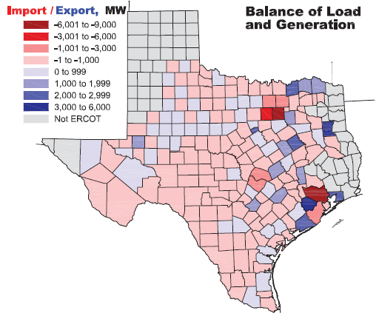
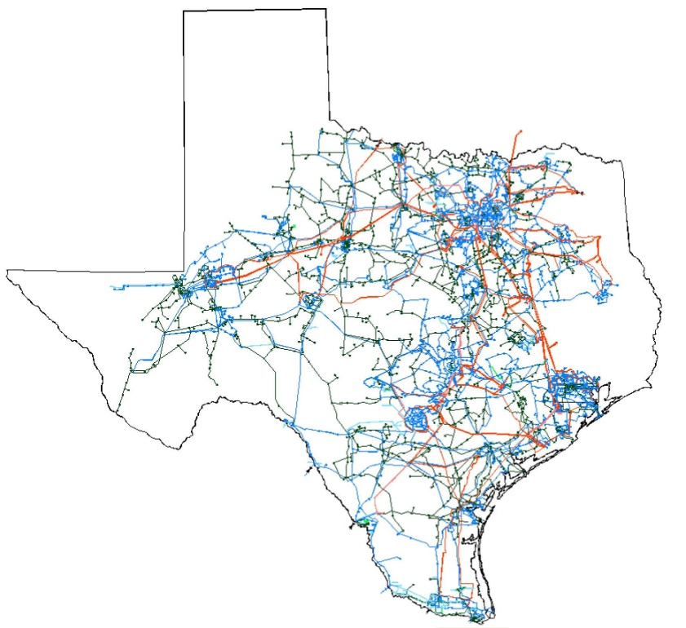
Energy Balance and Transmission
Balance of Load and Generation, Summer of 2010
(ERCOT 2010 Constraints and Needs Report)
Crockett county region imports electricity during high demand.
This project would offset small amount of regional import.
Close proximity to existing grid for transmission.
Crockett County Geothermal Field
ERCOT electric transmission grid

Slide 22
Conclusions
Geothermal energy production is a natural transition for waning gas reservoirs.
  Uses existing infrastructure, pipes, wells, etc.
  Known reservoir characteristics.
  Minimal risk and much smaller capital investment.
High demand for alternative energy resources.
Decrease demand on foreign energy imports.
Get the most out of an existing infrastructure before abandonment.

Slide 23
Works Cited
Pratt & Whitney Power Systems, 2010, “Organic Rankine Cycle Technology Brochure,” http://www.pw.utc.com/Products/Power+Systems/Organic+Rankine+Cycle, p. 1-8
M. Richards, R.J. Erdlac Jr. and J. Abbott, 2008. Chapter 7, Geothermal Energy, “Texas Renewable Energy Resource Assessment,” S. Combs, Texas Comptroller of Public Accounts, State Energy Conservation Office, p. 1-18.
R.J. Erdlac, J., L. Armour, R. Lee, S. Snyder, M. Sorensen, M. Matteucci, and J. Horton, 2007. "Ongoing Resource Assessment of Geothermal Energy from Sedimentary Basins in Texas." Thirty-Second Workshop on Geothermal Reservoir Engineering p. 1-8.
Texas Railroad Commission (http://www.rrc.state.tx.us), -Data and Statistics, -Production Data Query System, -Production Data Query, -General Production Query, search by field (“Will O, Ellenburger”) http://webapps2.rrc.state.tx.us/EWA/productionQueryAction.do
M. Swain, K. N., H. Miller, J. Fallon, B. Weaver, A. S. Metcalf, 2007. "Case History: Acid Fracturing Deep, Hot Ellenburger." Society of Petroleum Engineers, p. 1-8.
Canter, K. L., Stearns, D. B., Geesaman, R. C., and Wilson, J. L., 1993. “Paleostructural and related paleokarst controls on reservoir development in the Lower Ordovician Ellenburger Group, Val Verde Basin,” in Fritz, R. D., Wilson, J. L., and D. A. Yurewicz, D. A., eds., Paleokarst related hydrocarbon reservoirs: SEPM Core Workshop No. 18, New Orleans, April 25, p. 61-101.
Holtz, M. H., and Kerans, C., 1992, “Characterization and categorization of West Texas Ellenburger reservoirs,” in Candelaria, M. P., and Reed, C. L., eds., Paleokarst, karst related diagenesis and reservoir development: examples from Ordovician-Devonian age strata of West Texas and the Mid-Continent: Permian Basin Section SEPM Publication No. 92-33, p. 31-44.
T.D. Riney, 1991, “Pleasant Bayou Geopressured-Geothermal Reservoir Analysis-January 1991”
R. DiPippo, 2004. “Second Law Assessment of Binary Plants for Power Generation from Low-Temperature Geothermal Fluids”, Geothermics, V. 33, 2004, pp. 565-586. (Best paper in Geothermics for 2005.)
Malcom A. Grant, Paul F. Bixley, 2011. “Geothermal Reservoir Engineering, Second Edition.” Oxford: Academic Press ©2011.
GETEM: as provided by the DOE’s website http://www1.eere.energy.gov/geothermal/getem.html . Originally developed by the Idaho National Laboratory.
U.S. Department of Energy, www.eia.gov/renewable.

