Slide 1
GEOTHERMAL OPPORTUNITIES & CHALLENGES IN Latin AMERICA
Conventional and “Unconventional” Geothermal Resources
Bruce L. Cutright, Bureau of Economic Geology, University of Texas

Slide 2
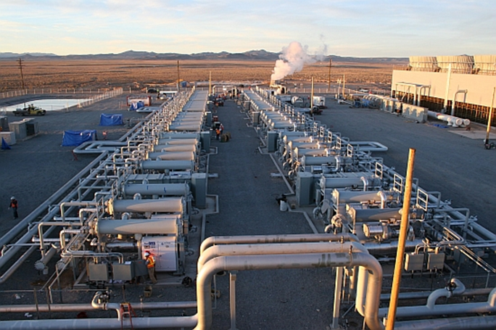
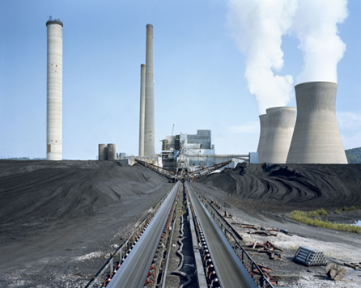
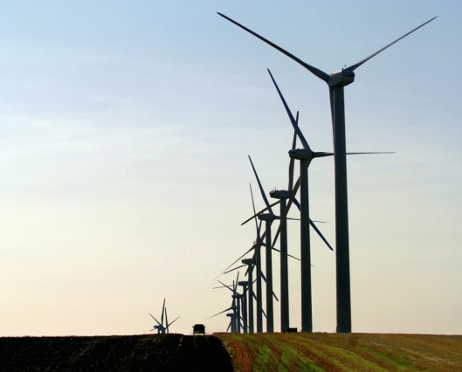
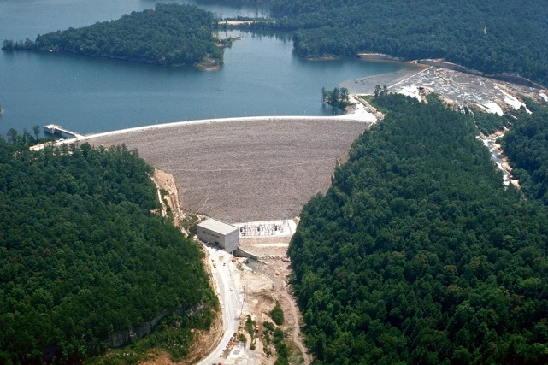
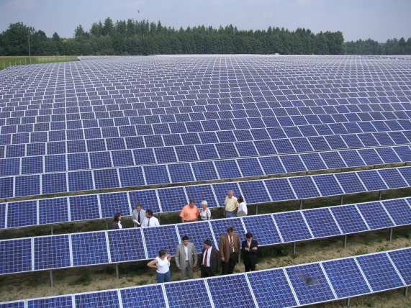
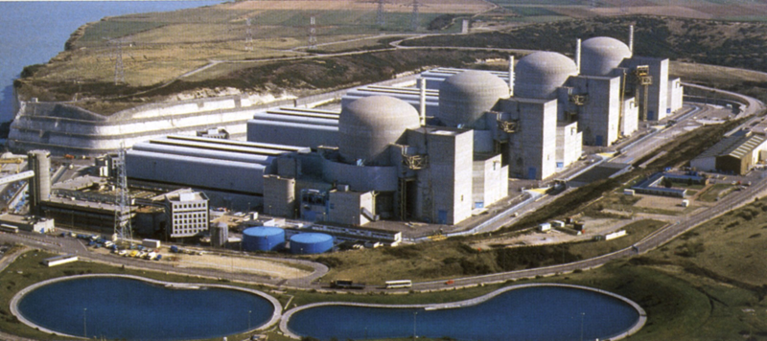
We have choices, each with advantages and disadvantages

Slide 3
GEOTHERMAL OPPORTUNITIES & CHALLENGES IN Latin AMERICA
The Answers First:
  Availability
  Land Use
  Water Use
  Carbon Dioxide Burden
  Costs of Construction and Operation
  Magnitude of the developable resource

Slide 4
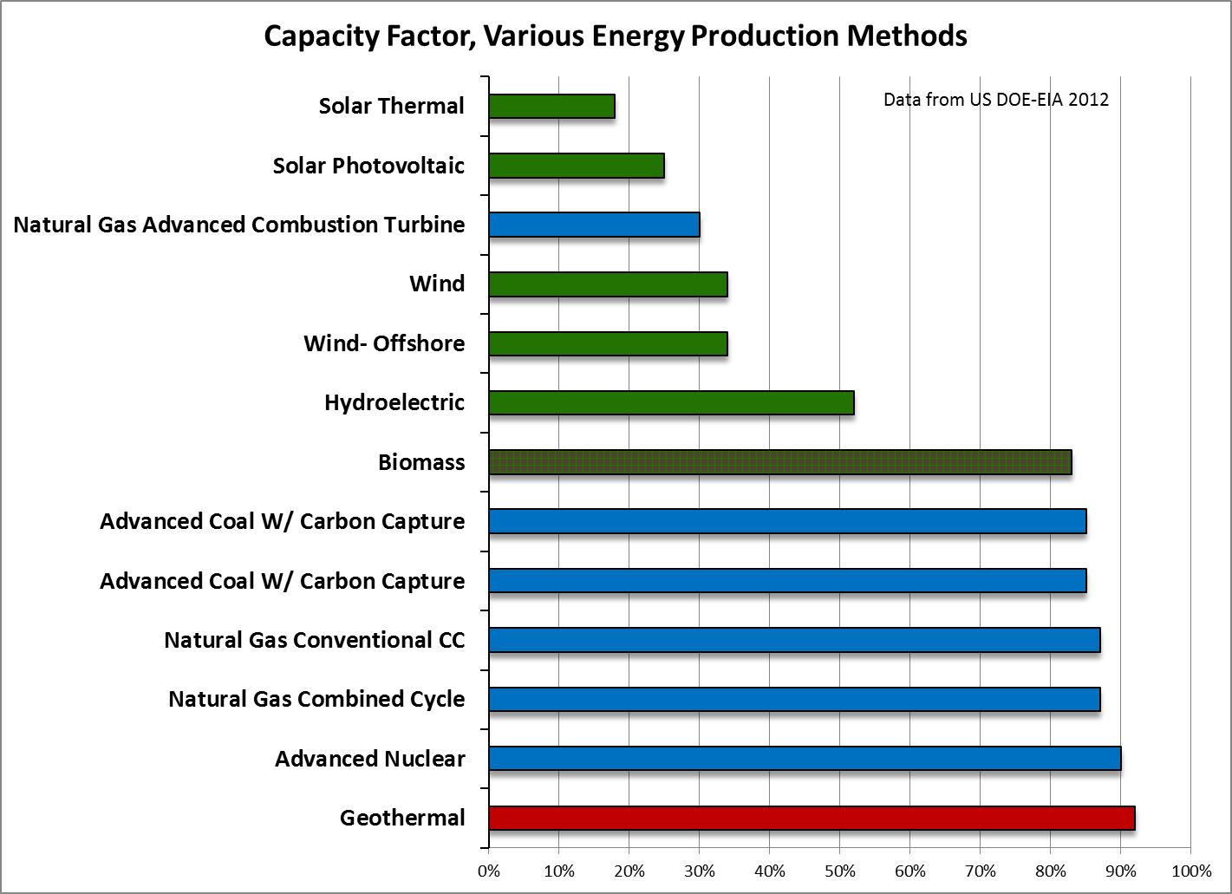
GEOTHERMAL OPPORTUNITIES & CHALLENGES IN Latin AMERICA

Slide 5
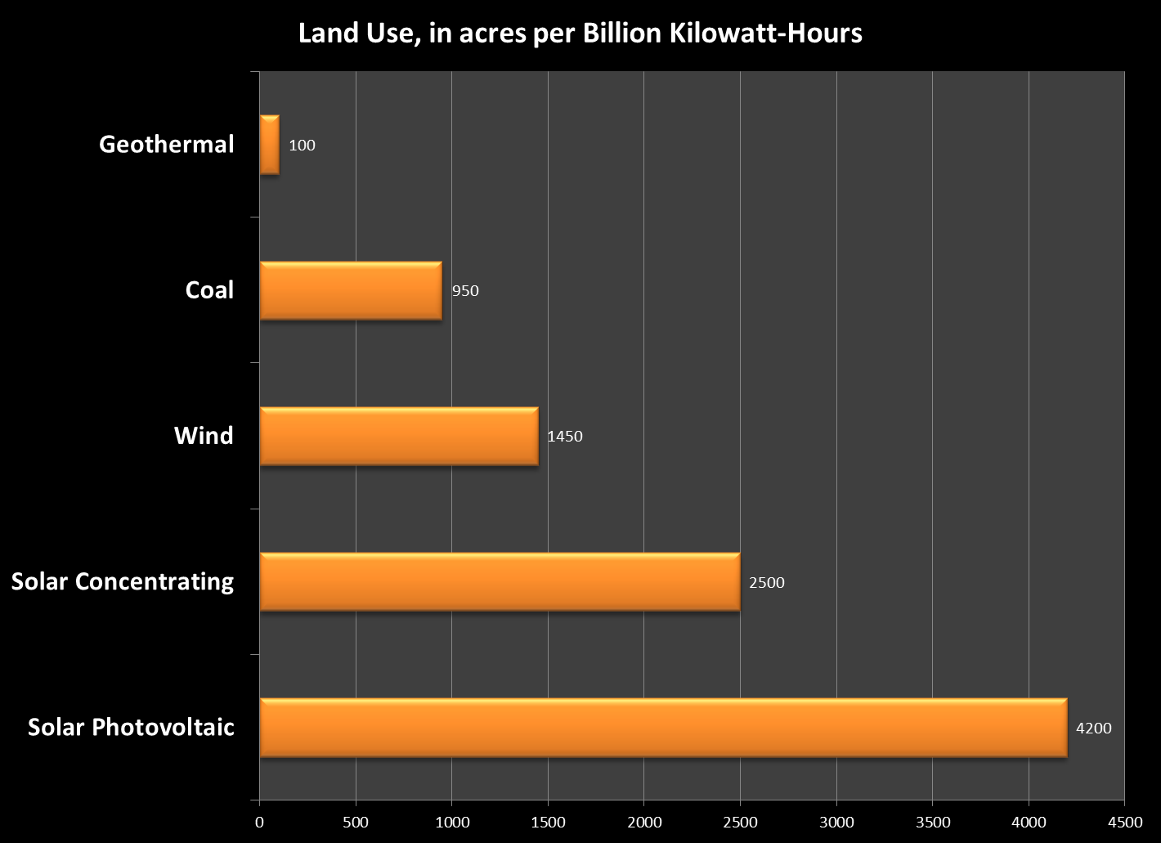
GEOTHERMAL OPPORTUNITIES & CHALLENGES IN Latin AMERICA

Slide 6
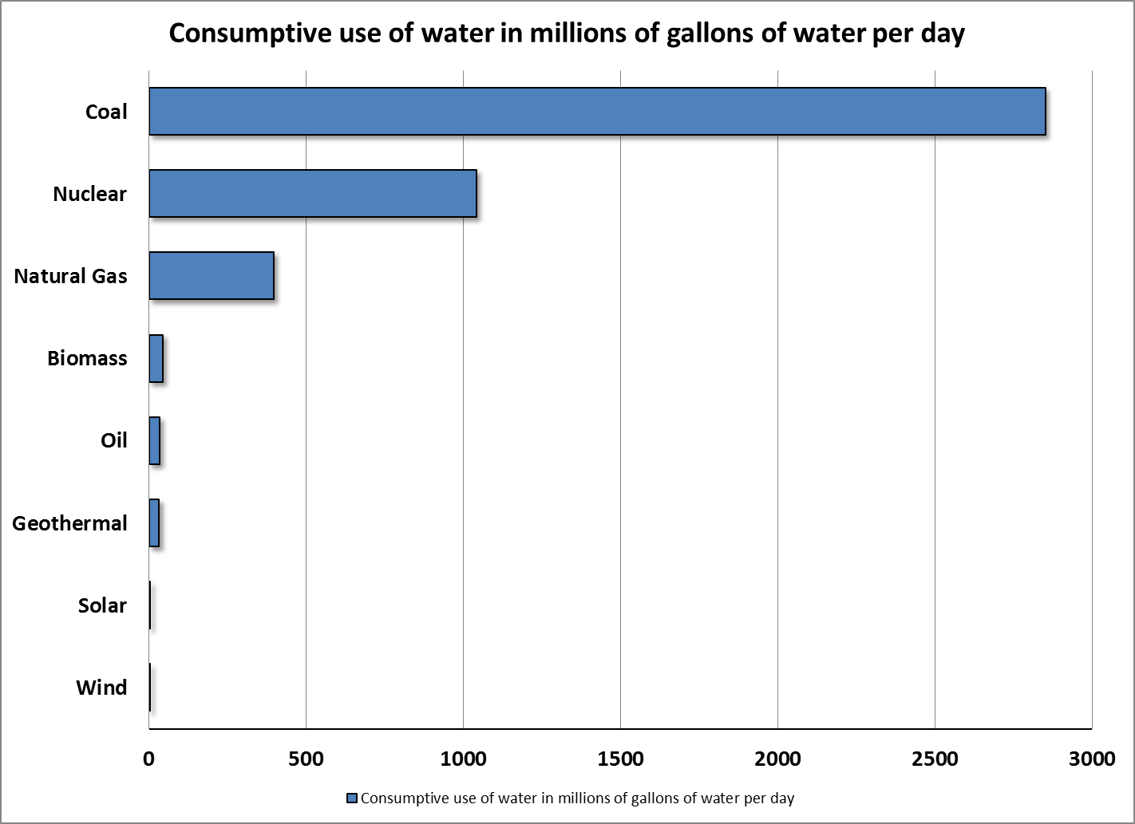
GEOTHERMAL OPPORTUNITIES & CHALLENGES IN Latin AMERICA

Slide 7
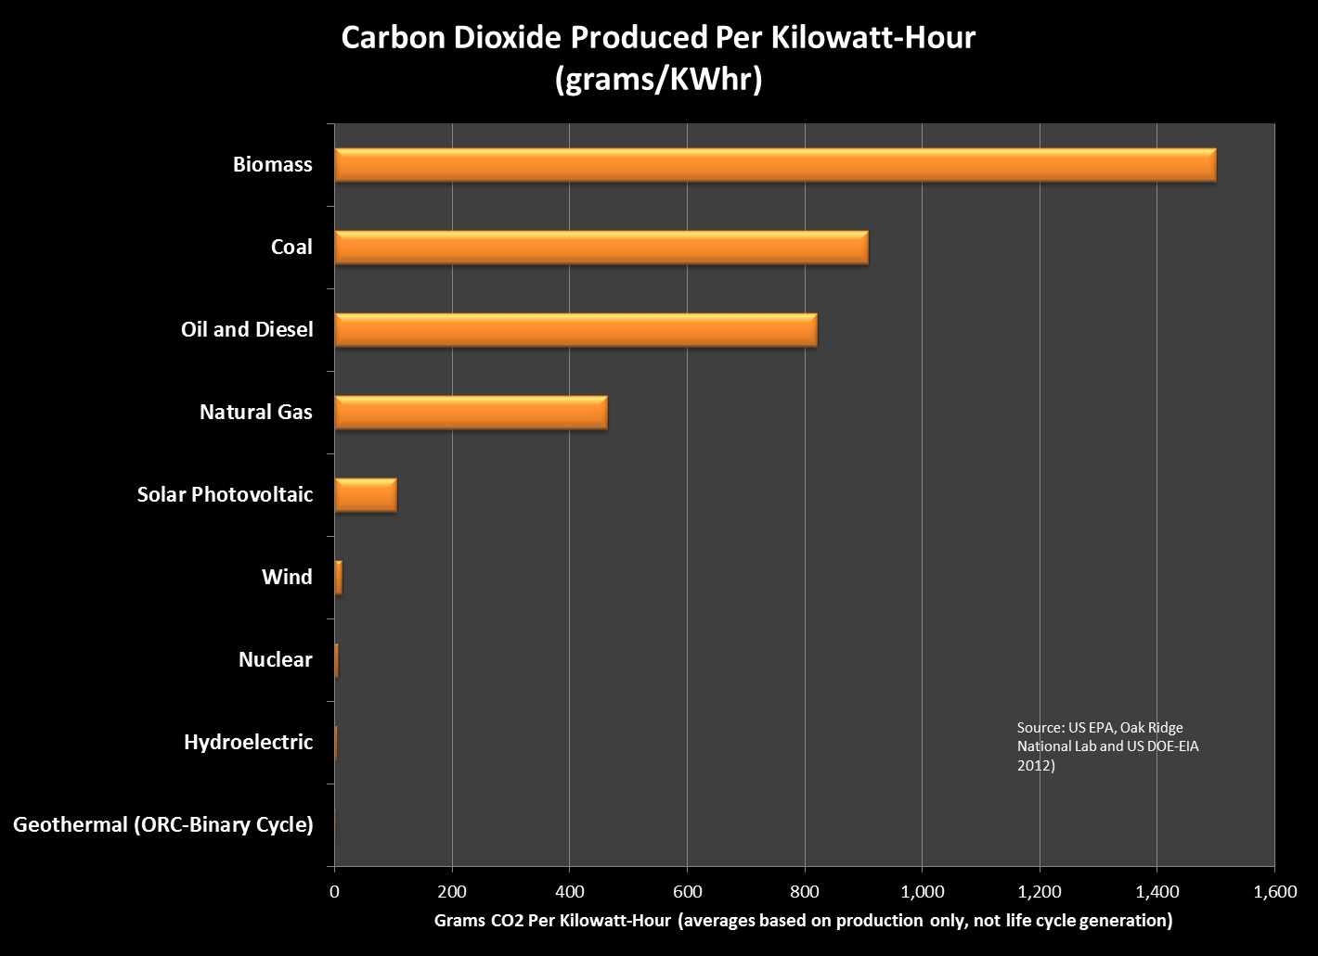
GEOTHERMAL OPPORTUNITIES & CHALLENGES IN Latin AMERICA

Slide 8
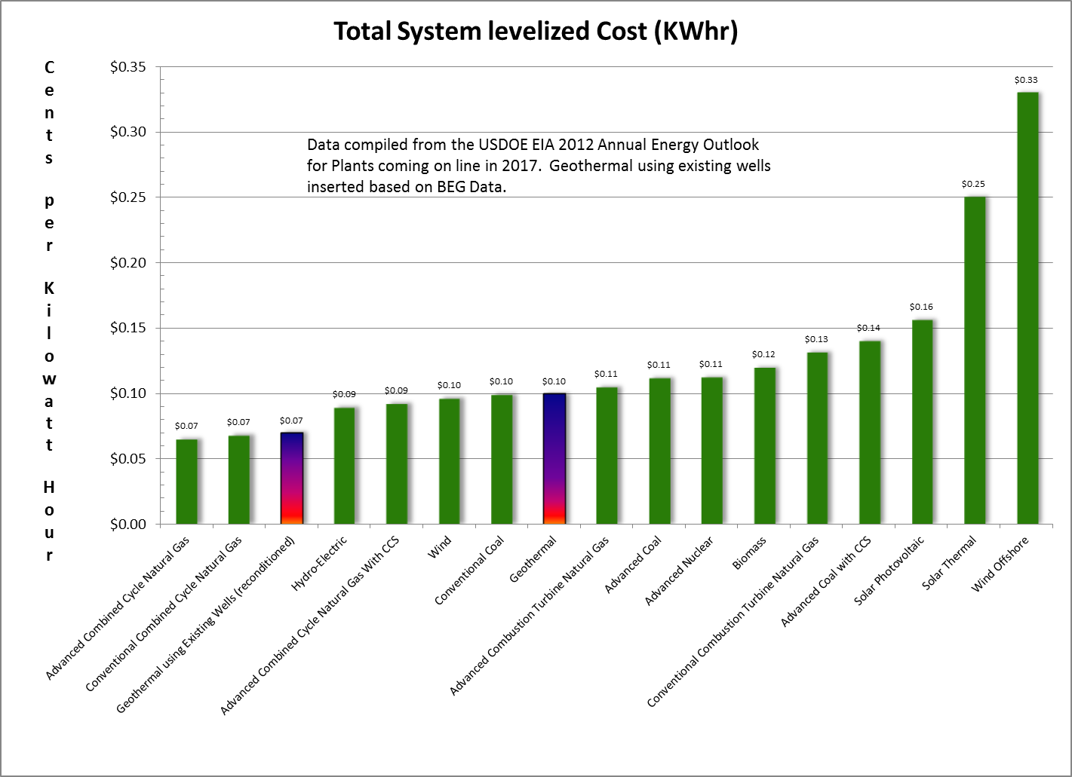
GEOTHERMAL OPPORTUNITIES & CHALLENGES IN Latin AMERICA

Slide 9
Why not mine heat, instead of mining coal, Oil or natural gas to produce heat?
Focus on Geothermal Opportunities and Challenges
  Challenges:
    Under-utilized and poorly understood renewable energy resource
    Less visible, and perceived to have a greater risk than Wind, Solar, or Biomass
    Aggressive (future) challenge from plentiful natural gas, wind and solar

Slide 10
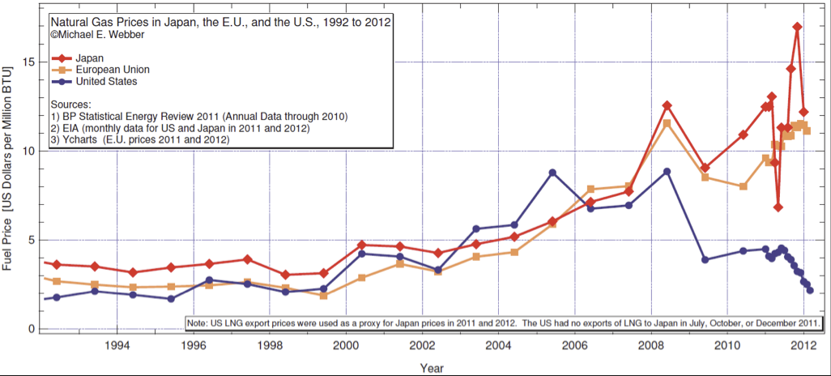
GEOTHERMAL OPPORTUNITIES & CHALLENGES IN CENTRAL AMERICA
Can Geothermal Energy effectively compete with natural gas?
  Volatility in Natural Gas Pricing is the best argument for Geothermal

Slide 11
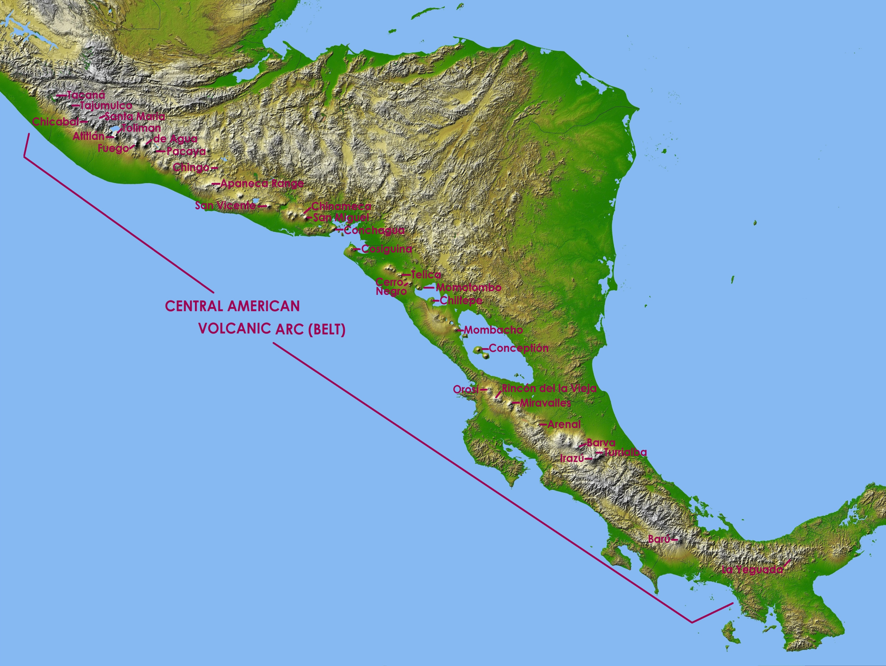

Geothermal Opportunities and Challenges in Central America
New Technology
Resource Magnitude
Energy Economics

Slide 12
Central American subduction zones & volcanoes
Funk et al., 2009
Slide courtesy of Paul Mann

Slide 13
Tectonic setting of Central America
Funk et al., 2009. Slide courtesy of Paul Mann

Slide 14
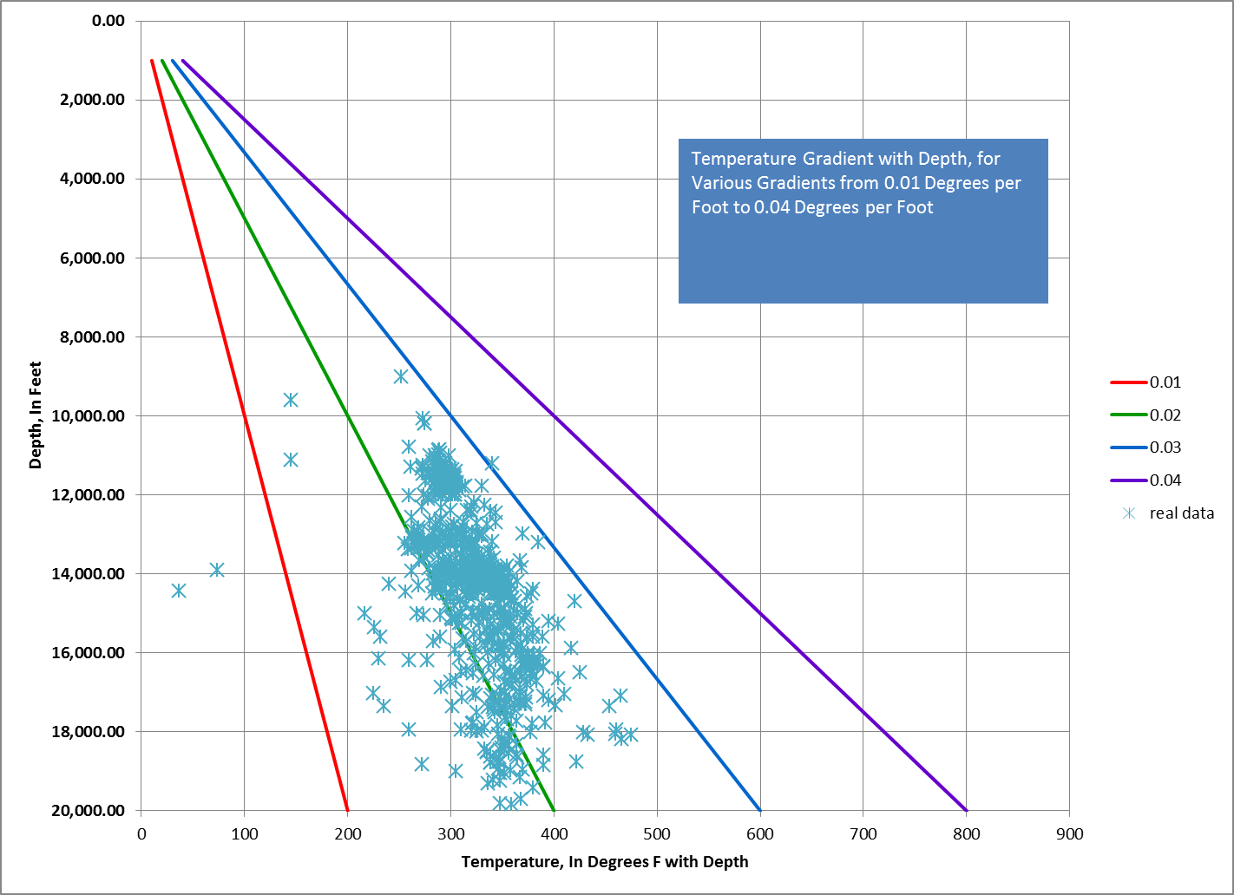

Slide 15
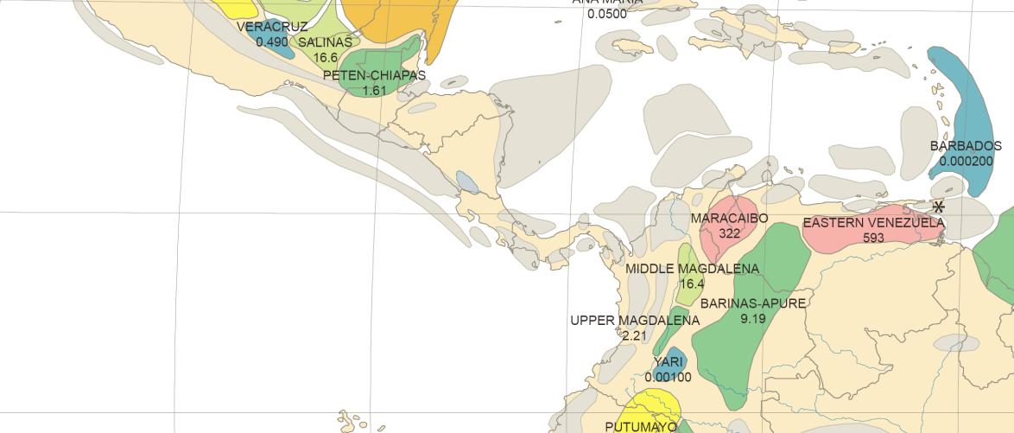
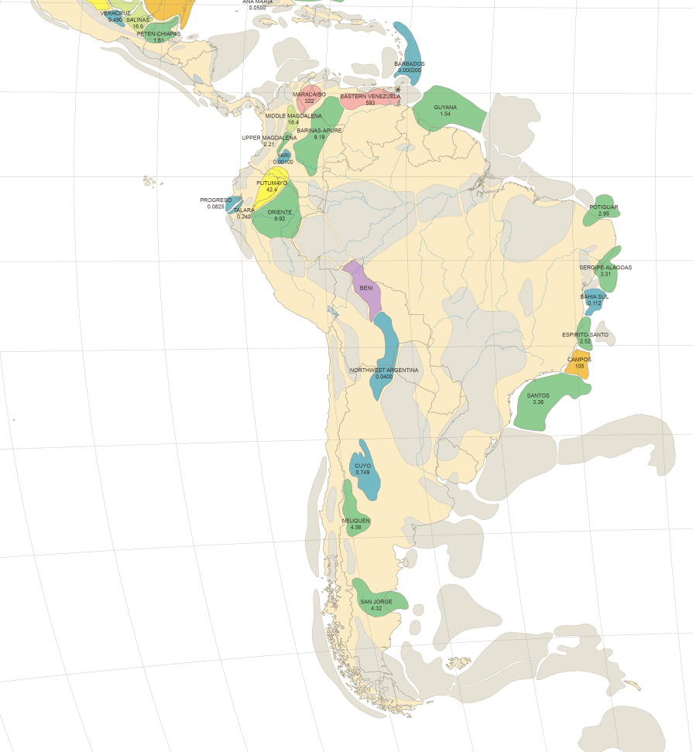
Geothermal Resource Potential in Central America
Sedimentary Basins in Central and South America, that are both potential petroleum provinces and targets for geothermal energy development.

Slide 16
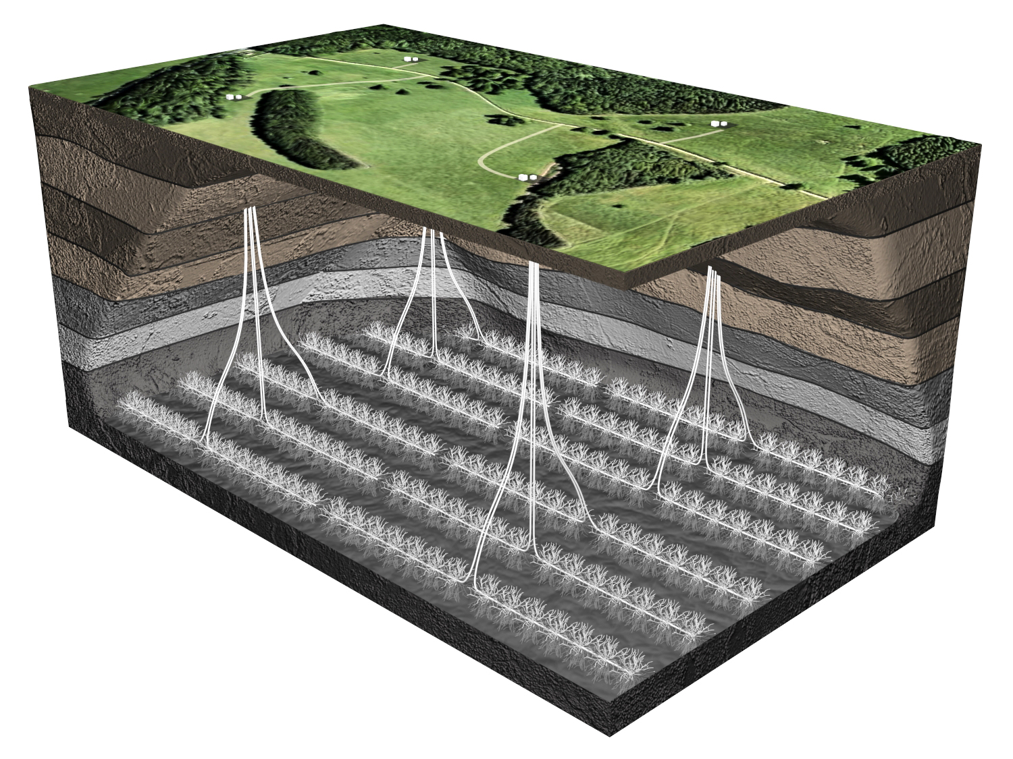
It is not necessary to
have magmatic hot spots,
or volcanic terrains to develop
geothermal energy. Intelligent application
of directional drilling and formation stimulation
can open hot, but low permeability formations to
geothermal energy production.
Illustration Courtesy of STATOIL 2010

Slide 17
Amatitlan Power Plant, Guatemala

Slide 18
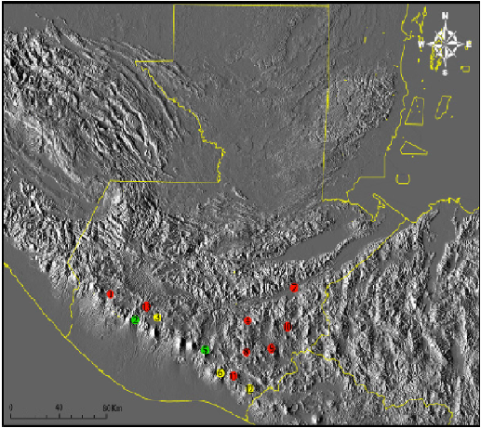
GUATEMALA GEOTHERMAL POTENTIAL
Total Geothermal resource potential from 3,320 to 4,000 Mwe (Battocletti, 1999)
Today’s current technology can access up to 1,000 MW
Currently has 49.5MWe installed capacity
INDE holds exploration rights, exploration concession and power development are open to the private sector
Potential Geothermal Ares identified in Guatemala-
1. San Marcos
2. Zunil
3. Atitlan
4.Palencia
5. Amatitlan
6. Tecuamburro
7. Motagua
8. Ayarza
9. Retana
10. Ixepeque-Ipala
11. Los Achiotes
12. Moyura
13. Totonicapan
Production in place
Surface and Drilling Exploration Completed
Surface exploration only

Slide 19
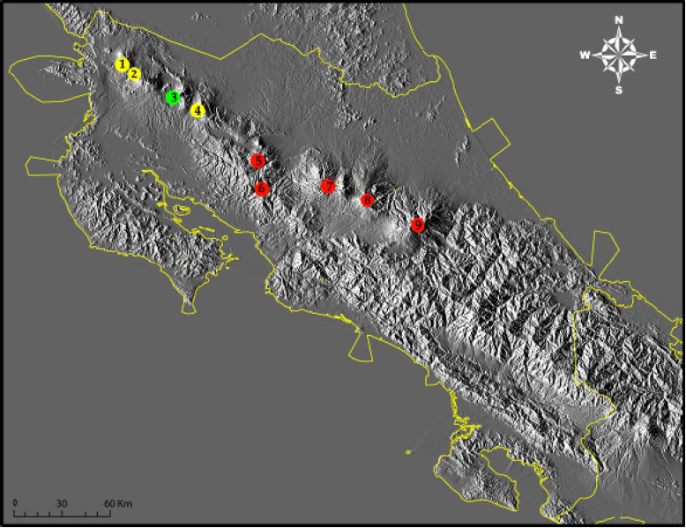
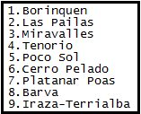

Costa Rica Geothermal Potential
Potential
High Enthalpy
High Permeability (Borinquen Field)
163 MW of installed capacity from geothermal plants
Limitation
Many geothermal identified regions are bounded within National parks. An example is the Rincón de la Vieja volcano located within the boundaries of Rincon de la Vieja National Park, thus preventing further studies of geothermal energy potential

Slide 20
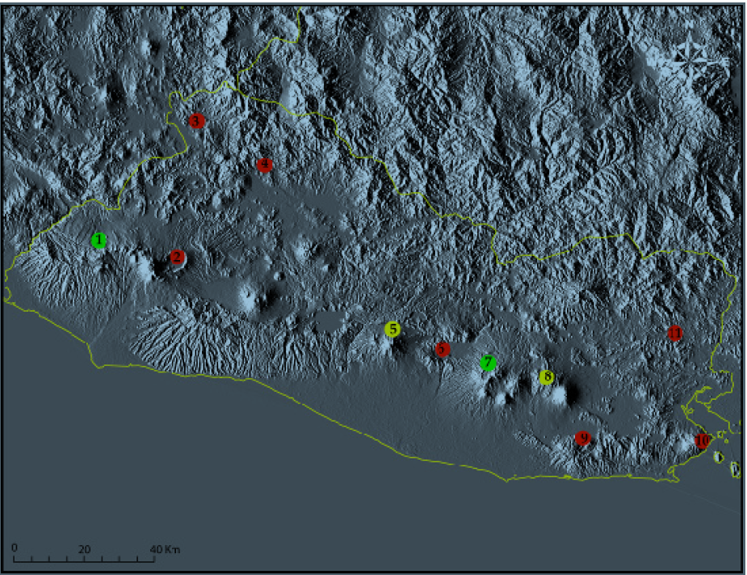
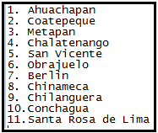
El-Salvador
Opportunities
El-Salvador has produced electricity from geothermal plants since the 70’s, large data/research and drilled wells sites already exit in areas of high geothermal potential
Electricity sector privatize in late 1990, private investors welcomed, fully competitive
Production in place
Surface and Drilling Exploration Complete
Surface exploration only

Slide 21
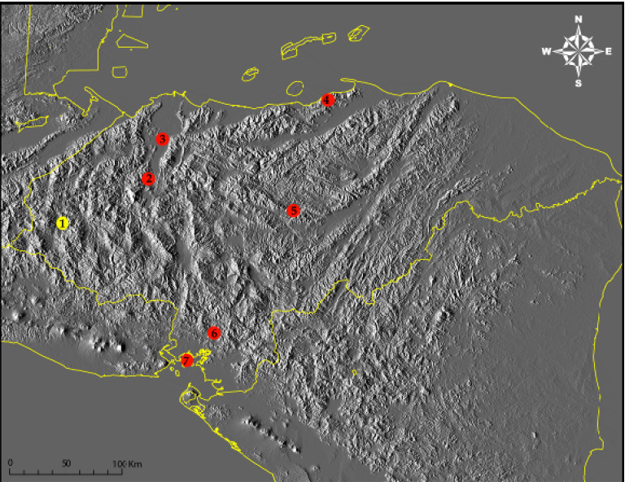
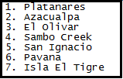
Honduras
Opportunities
At least 7 regions in Honduras have been identified to have high temperatures within easy drilling depths
Plantanares has the highest potential by far with a projected 35-50 Mwe yet no geothermal plant at the present time.
Production in place
Surface and Drilling Exploration Complete
Surface exploration only

Slide 22

Panama Geothermal Potential
First Exploration 1970, many hot springs and fumaroles however, most are not hot enough to generate electricity
Baru_Colorado (24 MW estimated)
Valle de Anton (18MW)
Chitre de Calobre
Tonosi
Coiba Island

Slide 23
Nicaragua
Potential
Energy demand is great- from 1993-1998 demand for energy grew by 28.7%, a projected 5.74% annual increase is expected (United Nation, 2005)
Public and Private ownership is offered
87 MW of installed capacity from geothermal plant

Slide 24
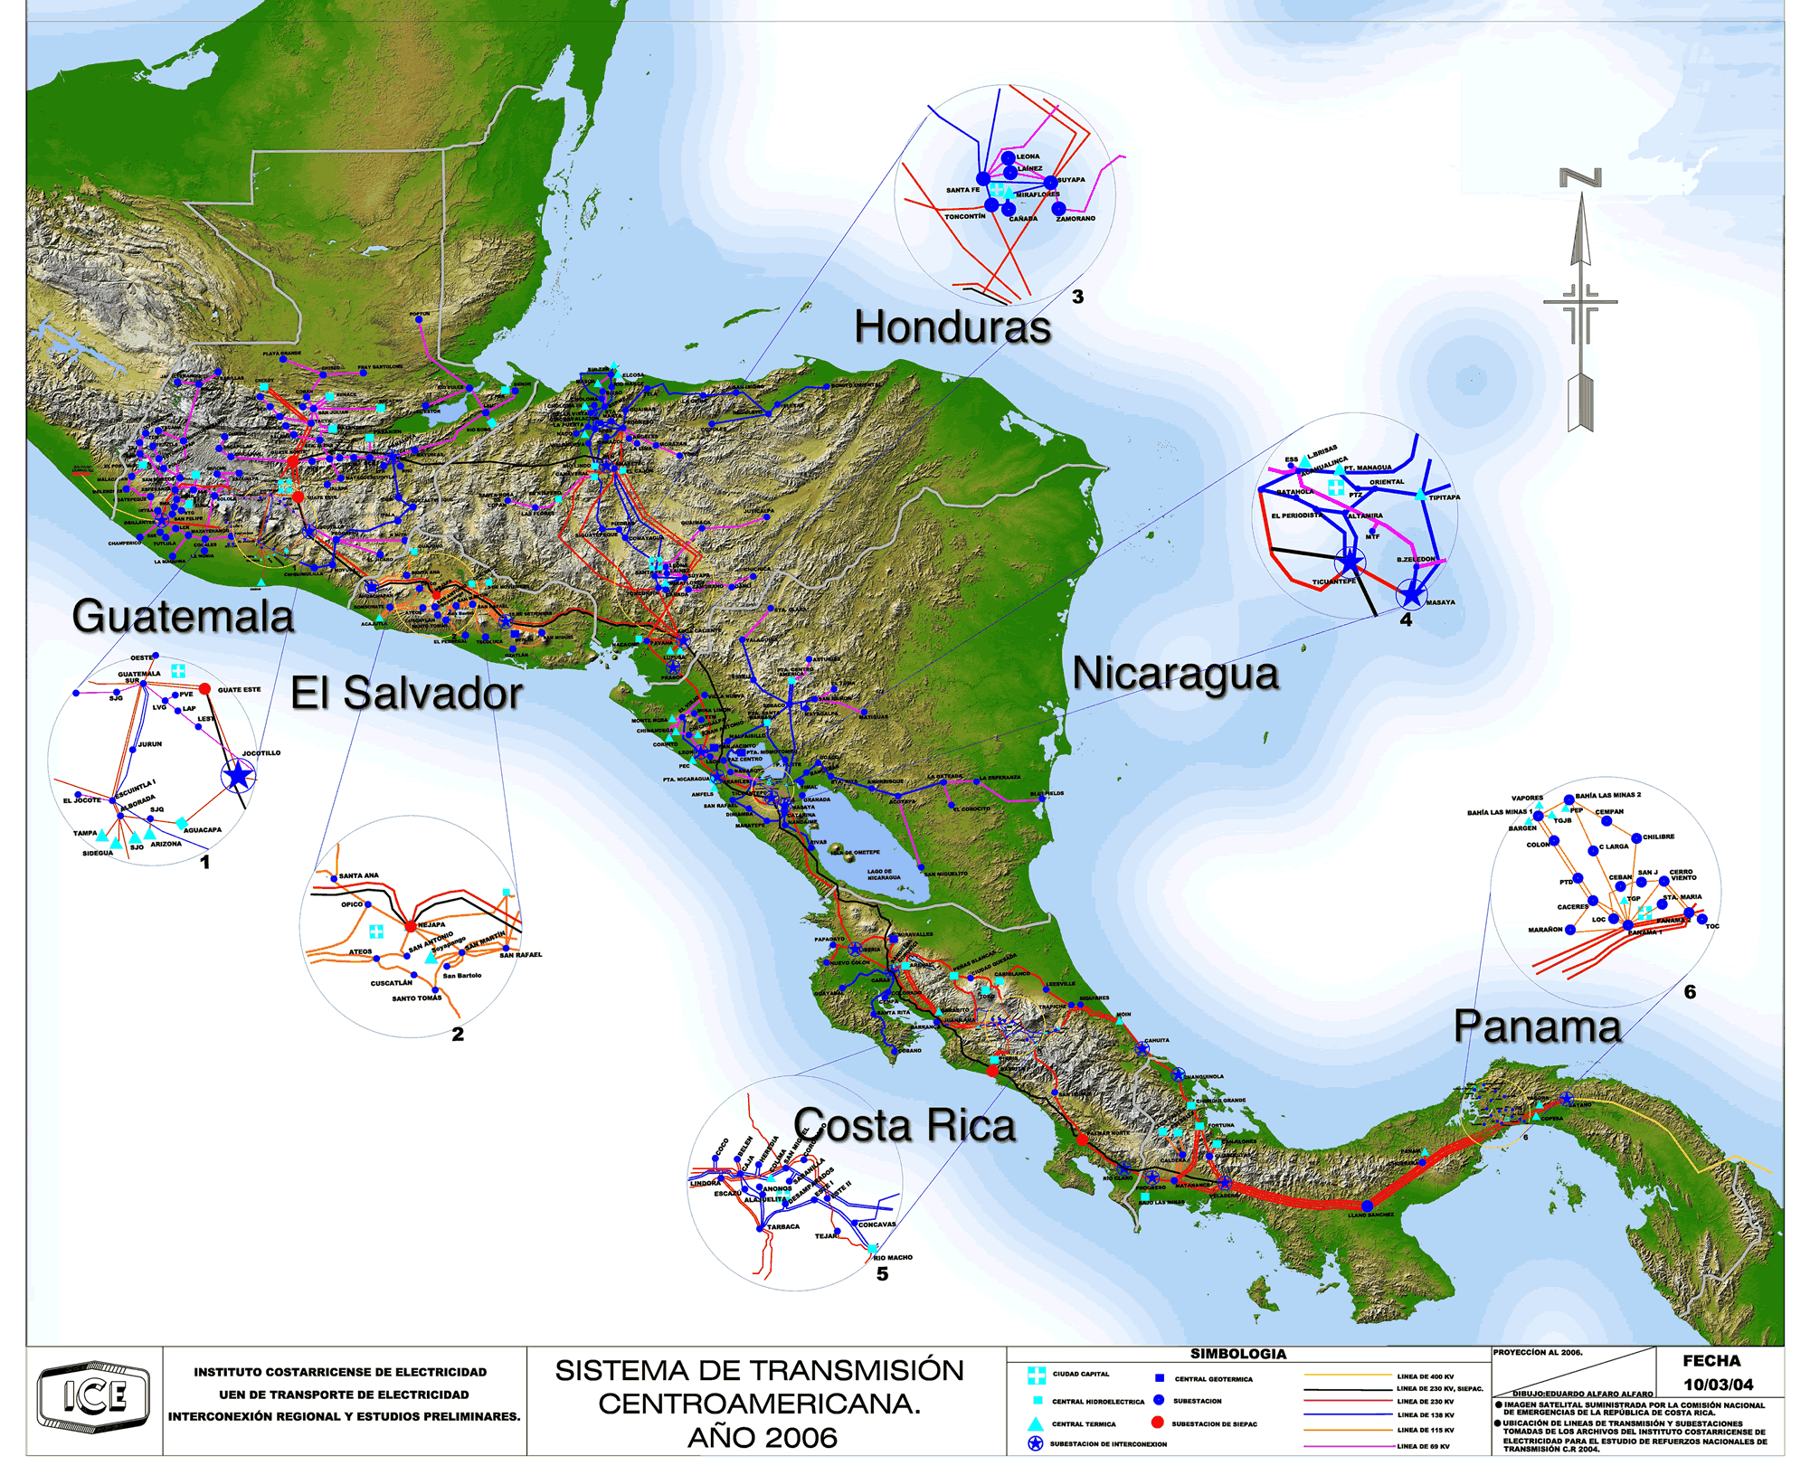

Slide 25
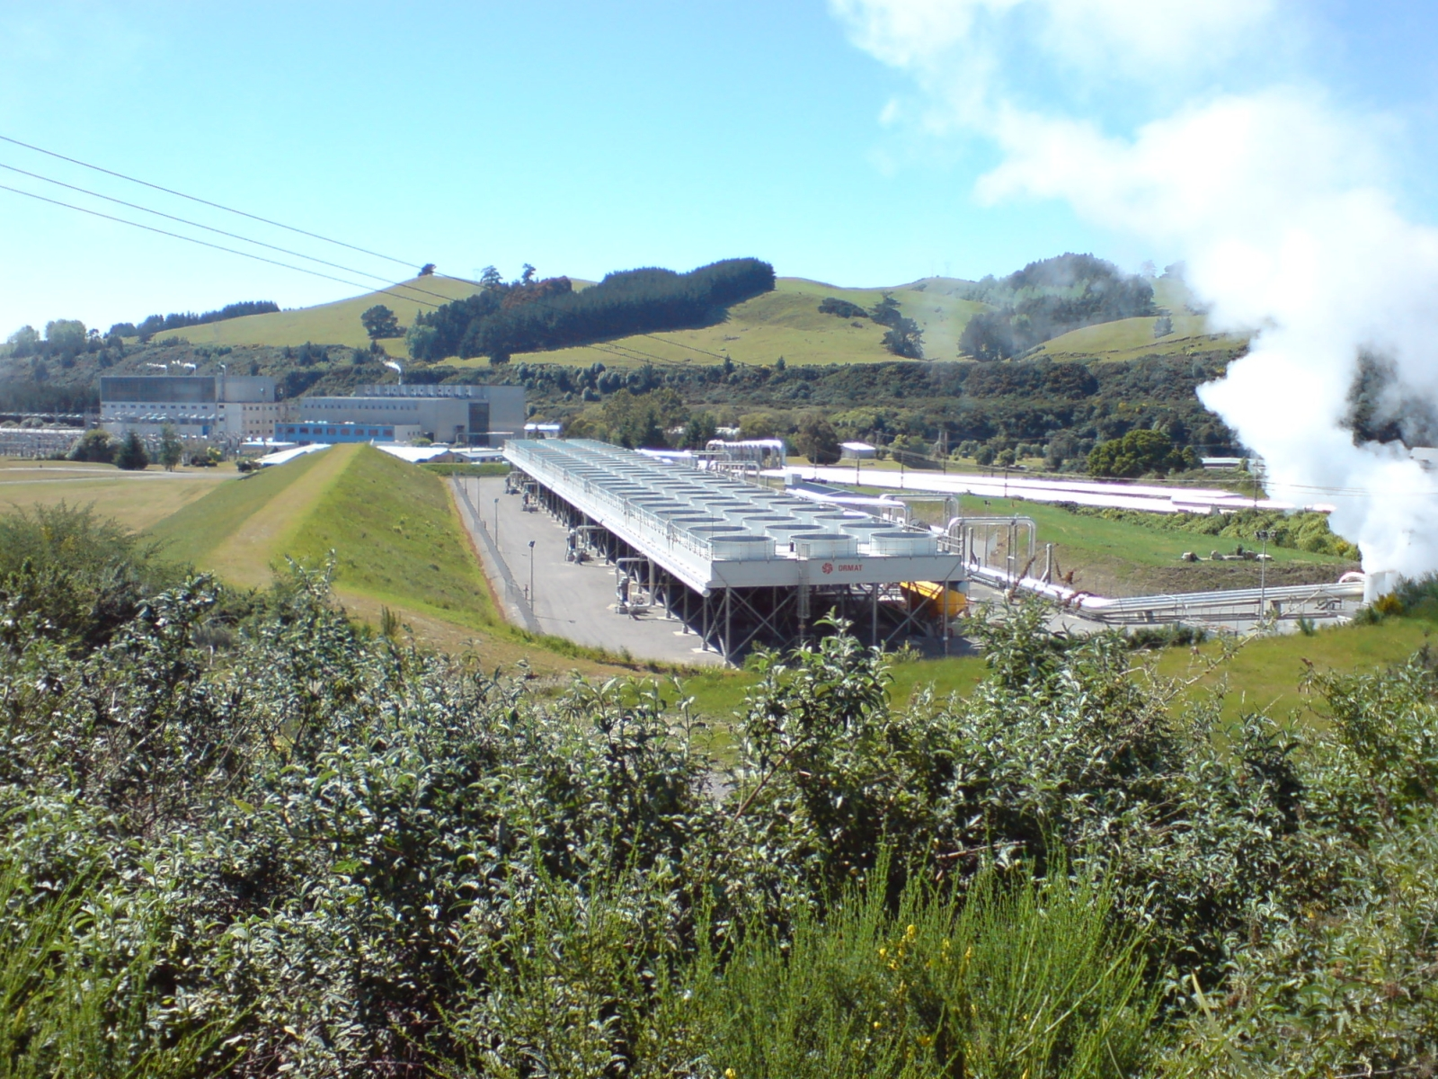

Slide 26
Geothermal Resource Potential in Latin America
The Impact of Transformational Technologies in Assessing Geothermal Energy
What can we expect the impact to be from a new assessment of extractable geothermal resources in Central and South America?
 |  | Potential Capacity in MWe
 | Installed Capacity, Thermal and Electric (2004) | Potential from Existing Magmatic Zones | Magmatic Zones including Pull-Apart Zones (unexplored areas) |  | Deep Sedimentary Basins Similar to Northern Gulf of Mexico
Central America | 850 | 19,720 | 39,440 | 98,600 | 98,600 | 197,200
South America | 210 | 14,660 | 29,320 | 73,300 | 73,300 | 146,600
 |  | 34,380 | 68,760 | 171,900 | 171,900 | 343,800
Modified after Sandia Labs, 2007. MIT 2007. Petty and Porro, NREL, 2007. USGS Cir 1249, 2003.

Slide 27
[Energy] Opportunities and Challenges in Central America
Energy
Water
Agricultural Production
Education
Health
Infrastructure
Economic Growth and Development is linked to:
  Available energy supply and per capita energy consumption
  Abundant (high quality) water supply for municipal, agricultural, industrial, energy production and Human Health
  Reliable infrastructure to produce and distribute Water, Energy, Food, resulting in
  Improved education, health, well-being, and political stability.
Dynamic, Expanding Economy;
Food and Energy Independence;
Political Stability

Slide 28
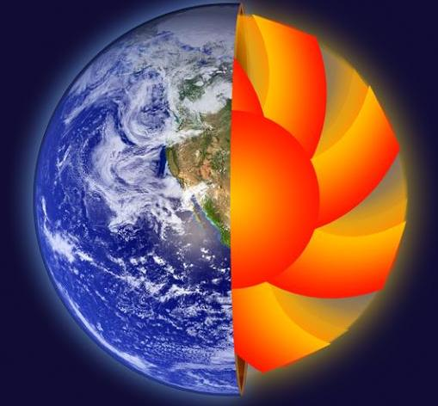
Thank you
Bruce L. Cutright
Bureau of Economic Geology
Jackson School of Geosciences
University of Texas

